Slide 1

INTRODUCTION TO DANIEL THWAITES

Slide 2
W elcome to Daniel Thwaites
Notes:
Start the induction with a welcome to the business and congratulation on being successful in the recruitment process
Include an icebreaker to get to know each other. Ask participants to introduce themselves
-Name
-Position/Department
-Previous Hospitality experience
-One interesting or fun fact about themselves

Slide 3
Contents
Today we will be covering…….
1.
Our Story
2.
Introduction to our Teams
3.
Daniel Thwaites Purpose & Principles
4.
About Us
5.
Benefits
Notes:
Give an overview of what the induction will cover along with timings and housekeeping

Slide 4

Notes:
I am welcomed – I feel part of the family
This is all about our journey of commitment to our people in our business and it starts at induction.
Cared For, Supported, Proud, Valued, Motivated & Engaged is how we want an employees to feel as part of the Daniel Thwaites family.
The green parts of the imagine represent the teams across all our divisions
Innovation , Warm Hospitality , Eye for Quality and Craftmanship
These are our principles with in the business.
Our principles represents our culture

Slide 5
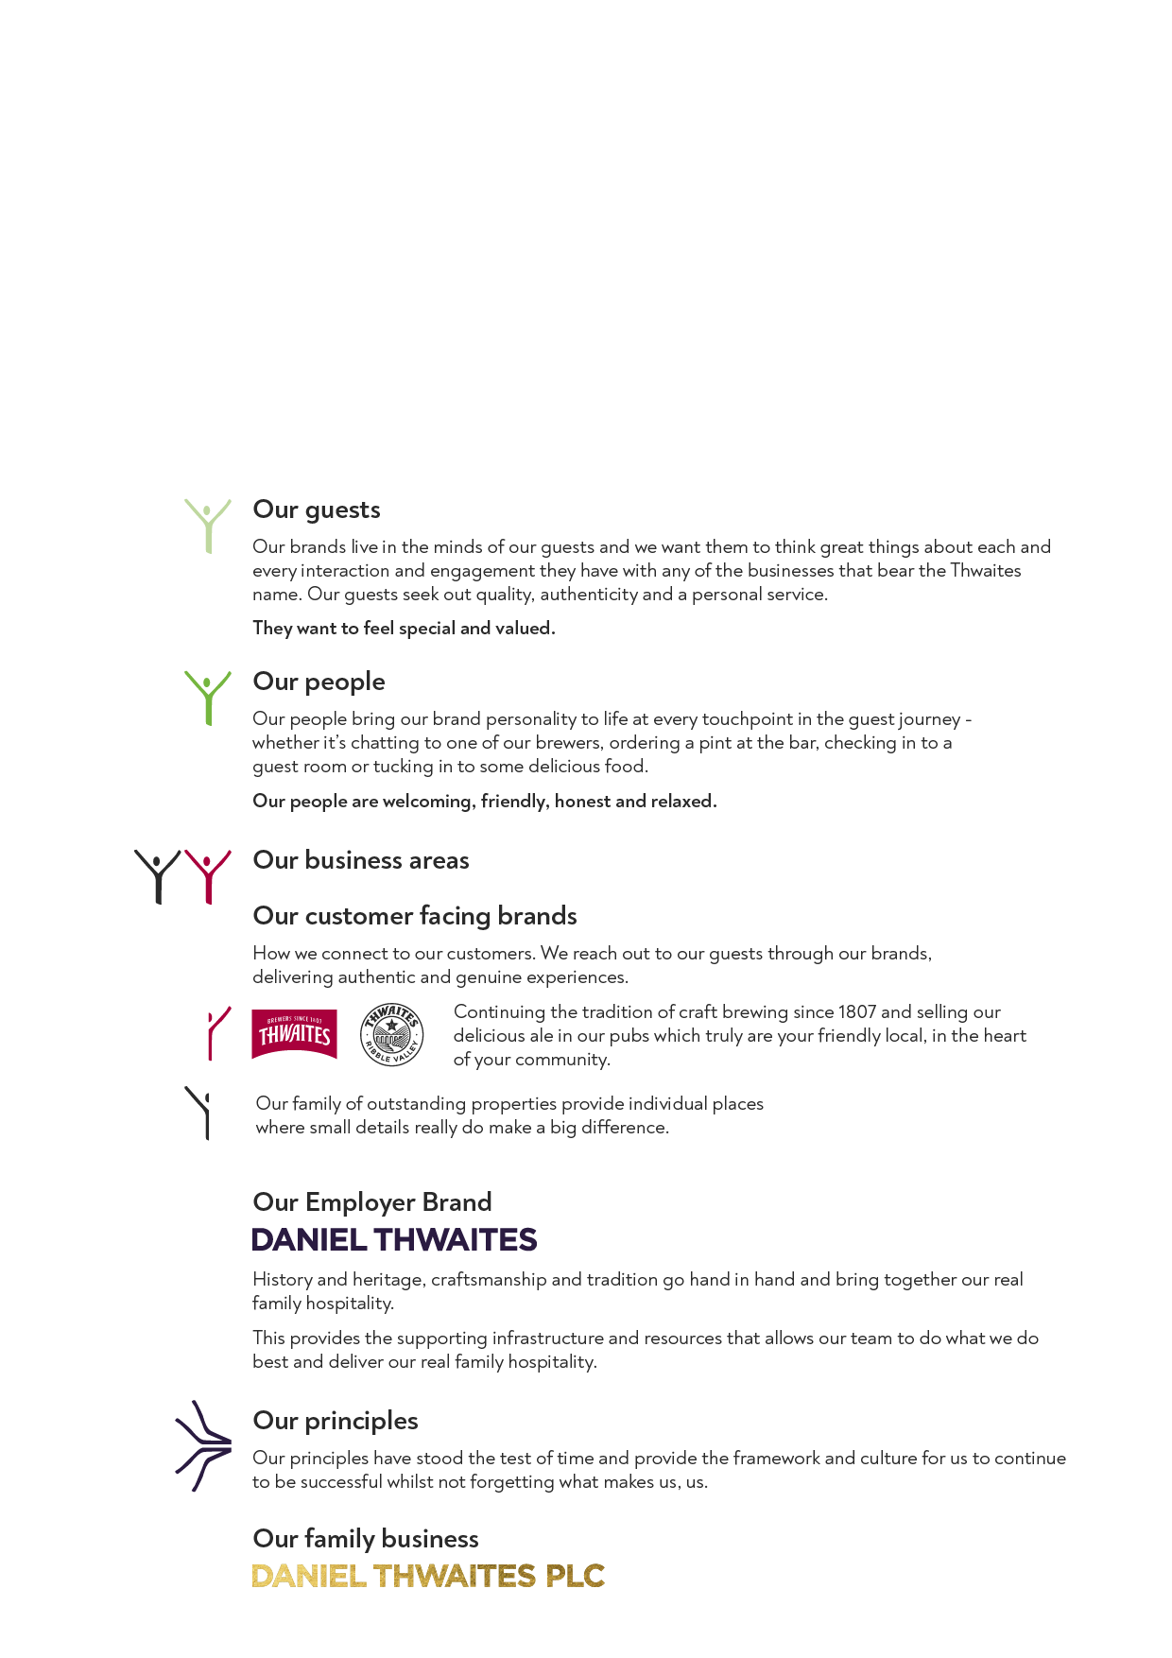

Daniel Thwaites Family Tree
Notes:
Our family is made up of many different parts, as you can see in our family tree.
(Talk through the family tree, using the guide on the right to help explain)
We are a team of 1800, our roots may be founded in Blackburn but we now stretch throughout England, from as far south as the Solent, to the Northern heights of Penrith and reaching across the land from sunny Blackpool to beautiful Beverley.
Our family involves a collection of 8 beautiful hotels and spas and 13 premium inns across the country, with teams working at each property to provide an amazing experience for our guests. Whether it be in housekeeping, reception, kitchen, maintenance, food and drink, bar, sales, social media, people or the spa, we really do have a talented bunch.
Are pubs are an important part of our business, and many of our landlords have run their pubs at the heart of their communities for years. They are supported by our Pub Operations team based from Head Office who help them to be the best that they can be, taking beer orders, generating new menu and drinks ideas and supporting their small businesses thrive. Our pub operations team also welcome two of our managed houses, The Flying Handbag in Blackpool and the Pendle Inn.
Brewing is in our blood, and our Brewery based in the Ribble Valley is home to our 5 brewers, passionate about their craft they have been brewing ales for us for years. In keeping with our tradition and heritage, we also have some very special members in our team, our shire horses who help share the Thwaites story at events up and down the country.
Our Inns, Hotels, Brewery and Pubs are all supported by our head office based in the Ribble Valley. We have teams including our Pub Operations, Finance & IT, Marketing, Estates and People, all passionate about helping improve our guests experience through the work they do.
Question: Can you describe how we fit into the Daniel Thwaites Family Tree?

Slide 6
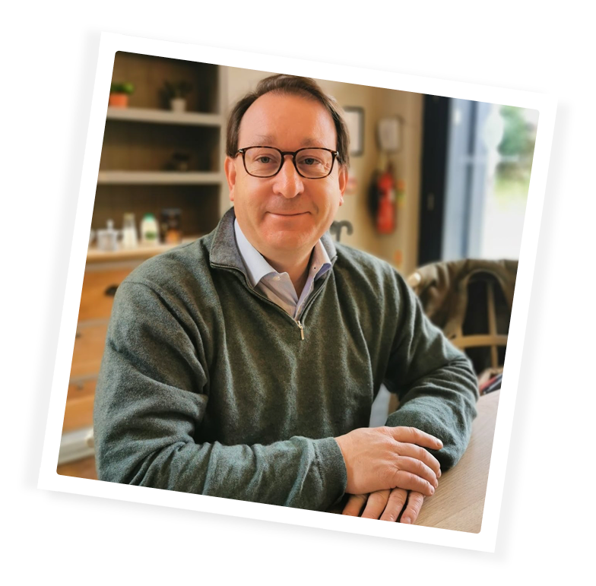

Meet our team…
Rick Bailey Executive Chairman
We have a fantastic opportunity across over 200 properties to help our customers enjoy themselves and have a great time. As a family business we can stand out from bigger corporate chains by being true to ourselves and being proud of who we are. With a human touch, being prepared to go the extra mile for our guests and each other, not compromising on the quality of what we do and being genuine and friendly – we won’t go far wrong.
Notes:
Our team members define us, and everyone has an important role to play in supporting our business. We are guided by our executive team who help us deliver business success. We asked them to share a few words of advice to help you to integrate into our business.
If you recognise any of these faces whilst at work, do say hello.. They are always happy to chat to our teams.

Slide 7
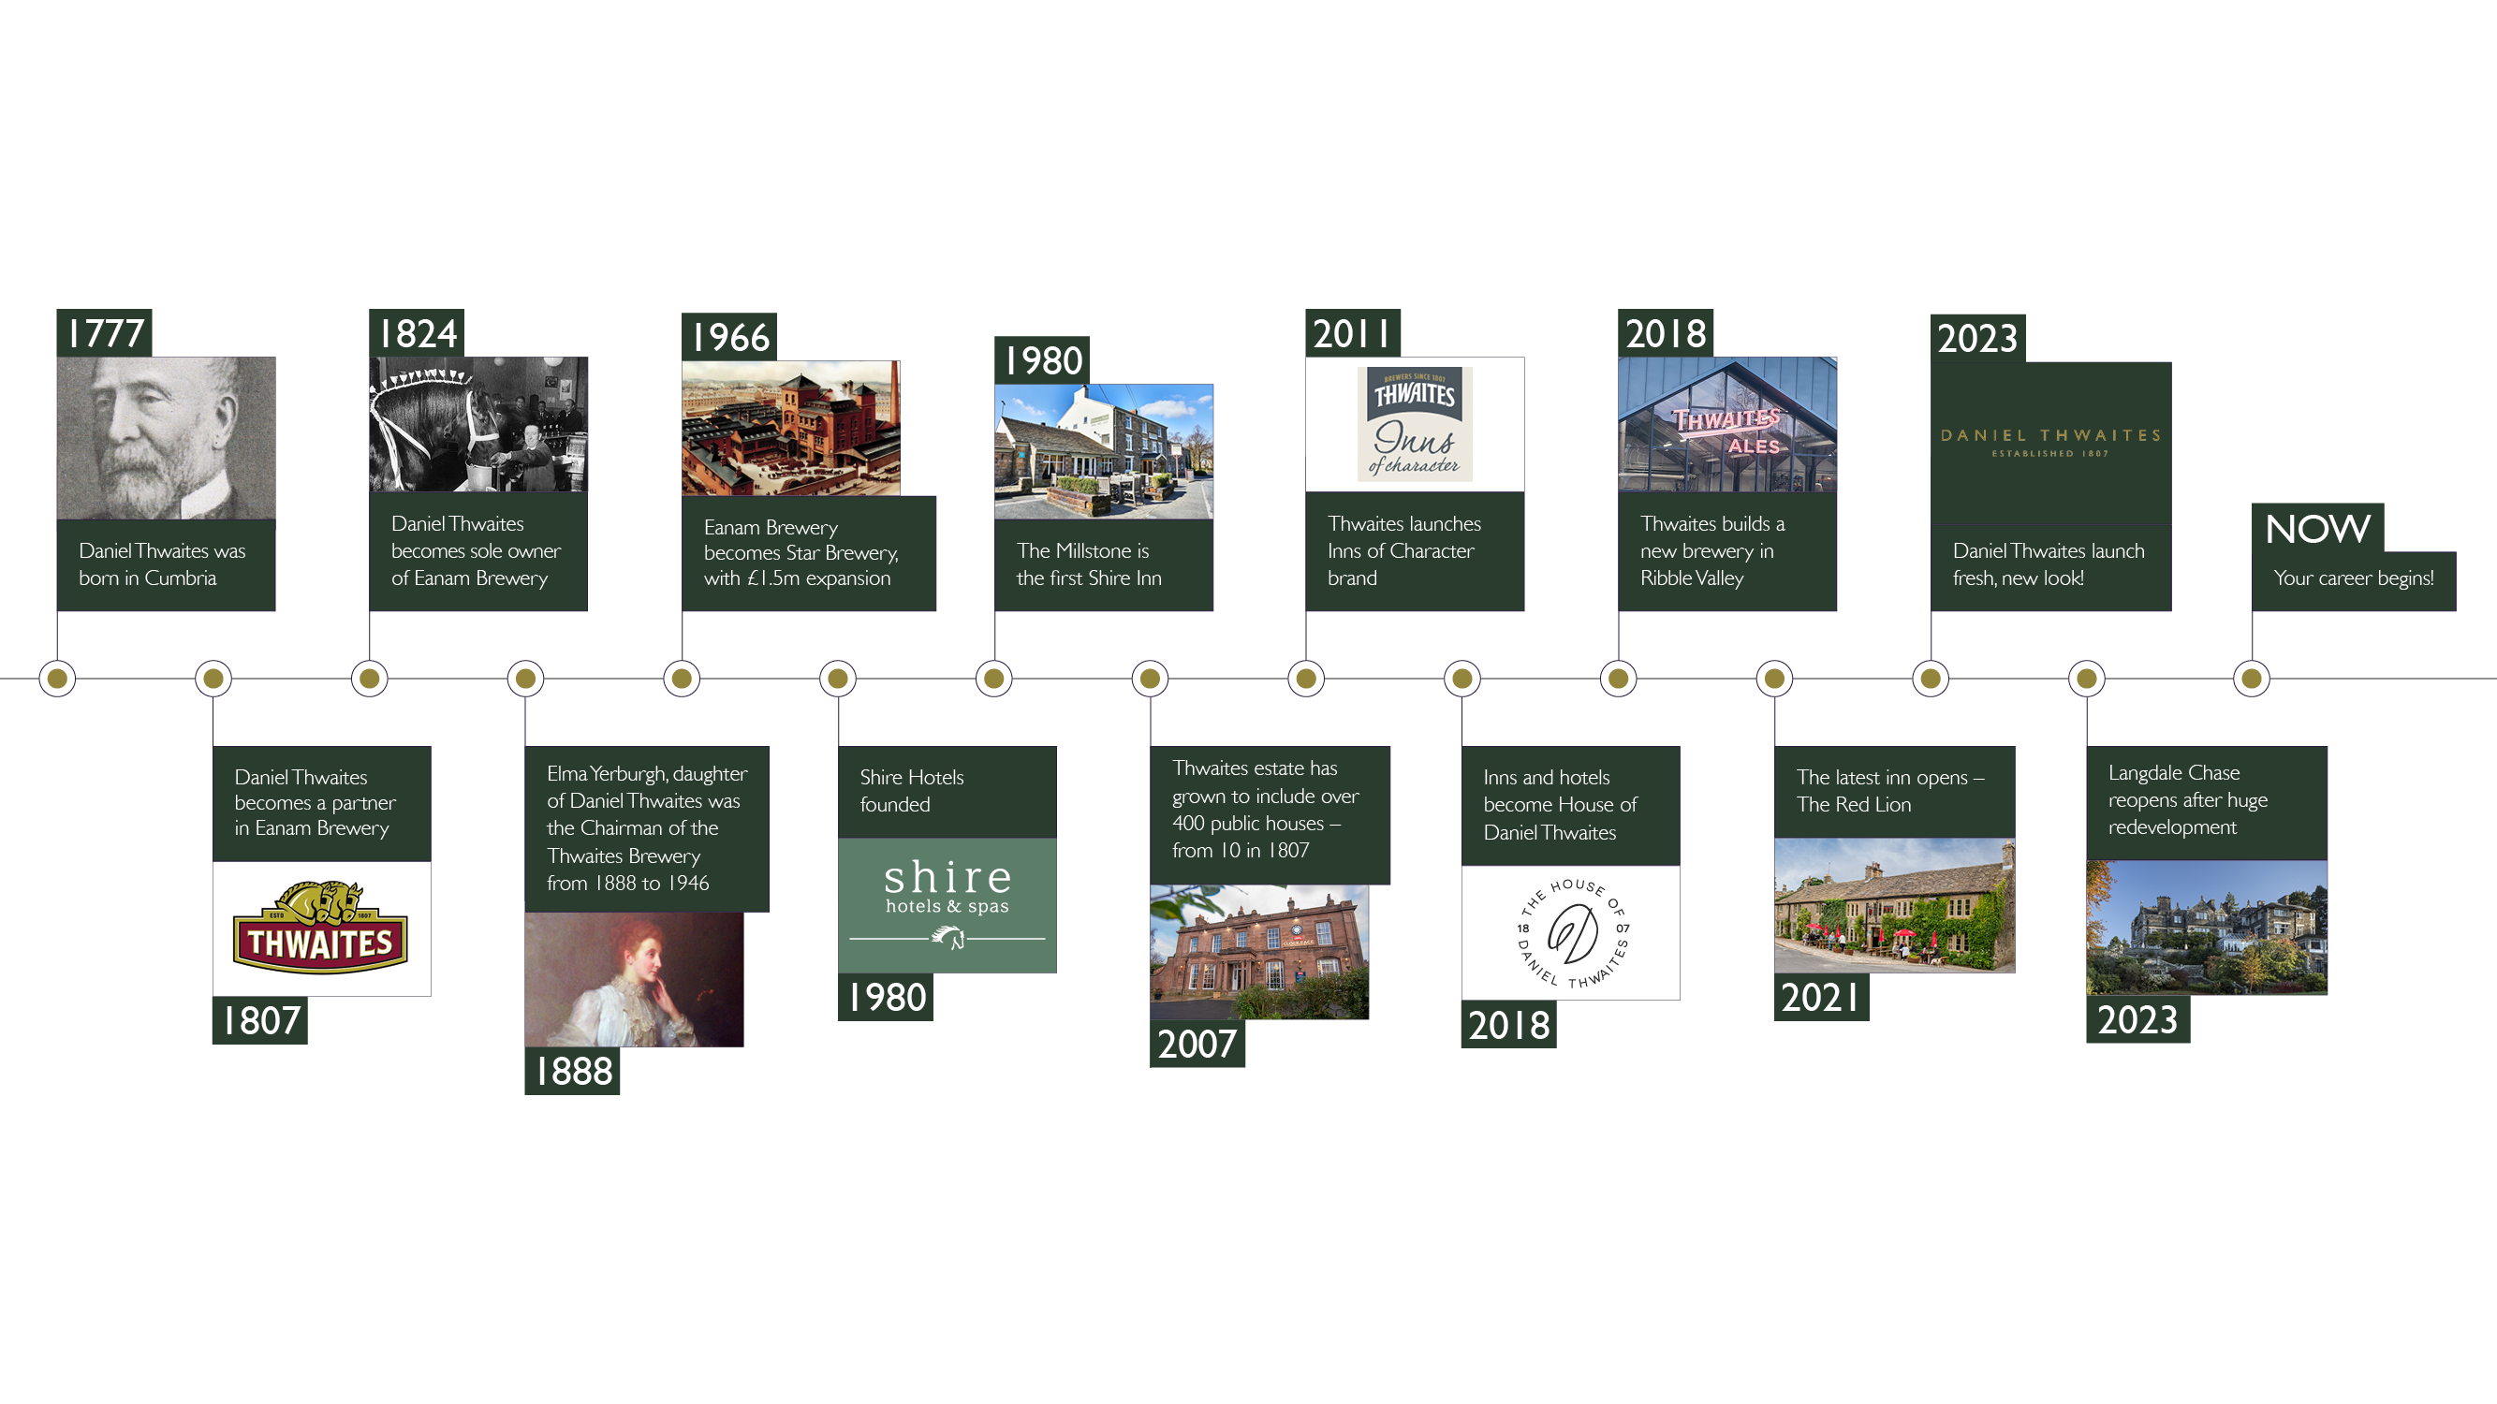
From humble beginnings…
Daniel Thwaites has been providing warm hospitality for over 215 years and are very proud to still be an independent family business.
Notes:
Our Story
In a world that’s changing faster than ever, it’s comforting to know that that some things withstand the passage of time. It is over two centuries ago since Daniel Thwaites set out from his family’s Lake District farm to make a new life for himself, and the rest they say, is history.
Daniel built up his brewery based on strong family principles - an eye for quality and a generous blend of innovation, craftsmanship and warm hospitality. Who would have believed, six generations later, that his family would proudly continue the journey Daniel started and remain faithful to his principles - still striving for brewing perfection, now with our warm hospitality extending to a growing collection of pubs, inns, managed houses, hotels and spas.
Today, we are passionate about our traditional values but time certainly hasn’t stood still. We are always looking to adapt to a changing world and for ways to improve to ensure we give you an experience that’s second to none. Above all, we know that with Thwaites, from our broad family of craft brewers in Lancashire, to our shire horses – still pulling their traditional drays, to our team members in properties up and down Britain, no matter where our guests choose to visit us, we will always guarantee a warm welcome from a friendly face.

Slide 8
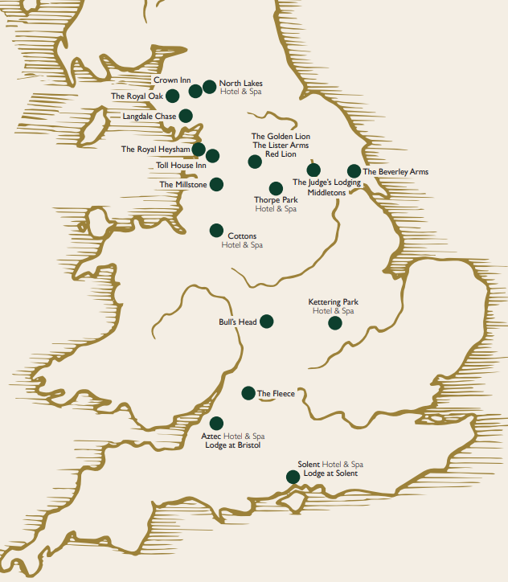
Our Properties

Slide 9









The Inns

Slide 10








The Hotels

Slide 11

Managed Houses

Slide 12


Our Customer Facing Brands
Our Brewery and Pubs
Our Managed Properties
Notes:
Our family is made up of many different parts, as you can see in our family tree.
(Talk through the family tree, using the guide on the right to help explain)
We are a team of 1400, our roots may be founded in Blackburn but we now stretch throughout England, from as far south as the Solent, to the Northern heights of Penrith and reaching across the land from sunny Blackpool to beautiful Beverley.
Our family involves a collection of 8 beautiful hotels and spas and 11 premium inns across the country, with teams working at each property to provide an amazing experience for our guests. Whether it be in housekeeping, reception, kitchen, maintenance, food and drink, bar, sales, social media, people or the spa, we really do have a talented bunch.
Are pubs are an important part of our business, and many of our landlords have run their pubs at the heart of their communities for years. They are supported by our Pub Operations team based from Head Office who help them to be the best that they can be, taking beer orders, generating new menu and drinks ideas and supporting their small businesses thrive. Our pub operations team also welcome two of our managed houses, The Flying Handbag in Blackpool and the Pendle Inn.
Brewing is in our blood, and our Brewery based in the Ribble Valley is home to our 5 brewers, passionate about their craft they have been brewing ales for us for years. In keeping with our tradition and heritage, we also have some very special members in our team, our shire horses who help share the Thwaites story at events up and down the country.
Our Inns, Hotels, Brewery and Pubs are all supported by our head office based in the Ribble Valley. We have teams including our Pub Operations, Finance & IT, Marketing, Estates and People, all passionate about helping improve our guests experience through the work they do.
Question: Can you describe how we fit into the Daniel Thwaites Family Tree?

Slide 13
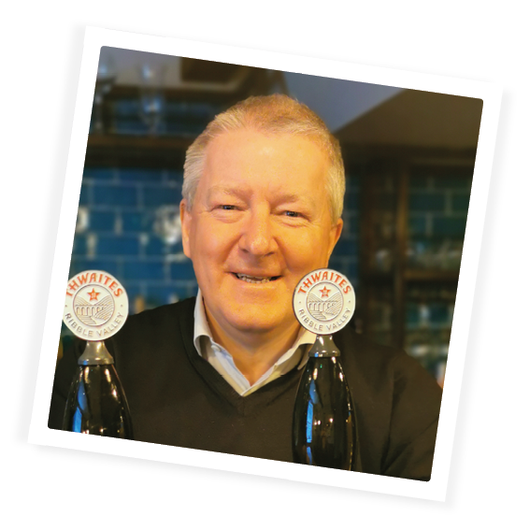
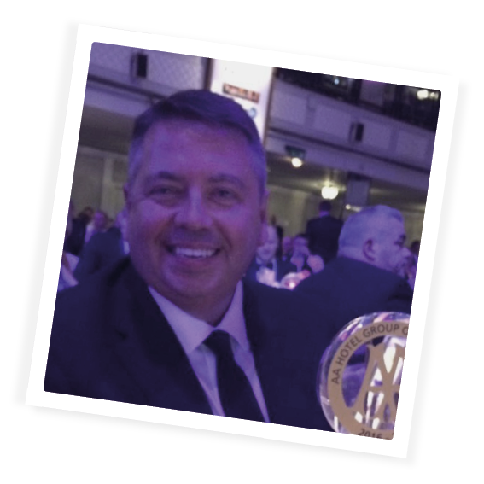
Meet our Operations Directors…
Mick Horan Operations Director – Inns
Andrew Buchanan
Director of Pubs & Brewing
Welcome to Daniel Thwaites. I hope you enjoy your time in the business as much as I have done. My role covers two parts of our business. Our Brewery is at the heart of our business which has brewing in its DNA. These days everything we brew is sold in our own Pubs, Inns and Hotels, please make sure you try some of our great beers! Our tenanted pub estate is about 220 pubs across the North of England supported by our great team of Area Business Managers and support staff. If you want to know more about how our pub business works, please get in touch, I love to talk!
Chris Hill Operations Director – Hotels
Remember to treat all guests and colleagues as you would like to be treated, always put yourself in our guests shoes and if a guests comes to you with a request, own that request until the guest is happy. Finally remember to smile and say good morning and afternoon to all guests as you pass them in the corridor
Notes:
Our team members define us, and everyone has an important role to play in supporting our business. We are guided by our executive board who help us deliver business success….. We asked them to share with you a little more about their role and their advice for you in your first few days at Daniel Thwaites.
If you recognise any of these faces whilst at work, do say hello.. They are always happy to chat to our teams.

Slide 14
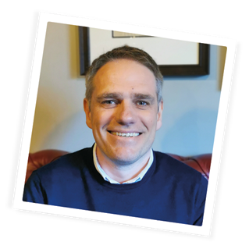
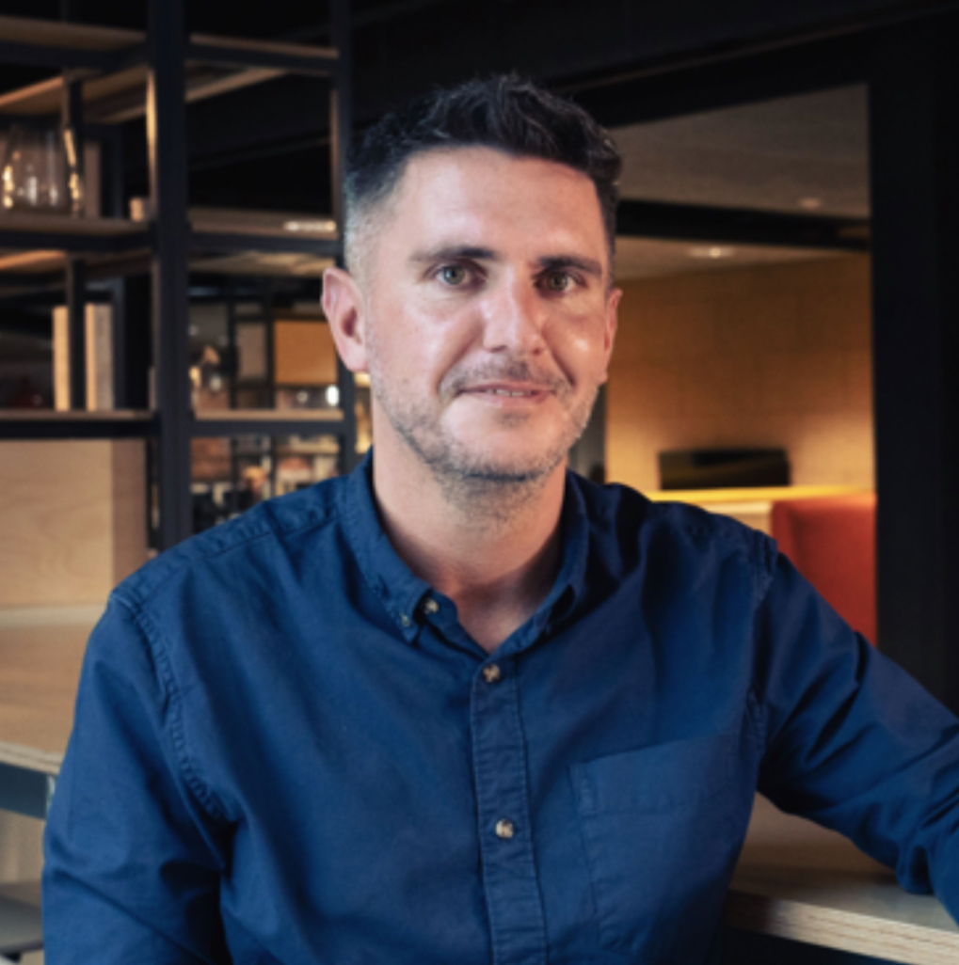
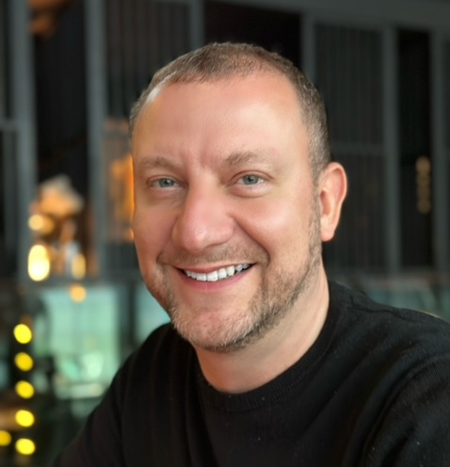
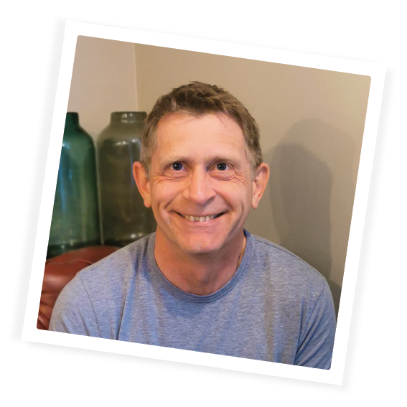
Meet our Support Team Directors…
Jim Francis Estates Director
This business is all about the people. Whether you are working in our fantastic properties or supporting those people to provide wonderful service to our guests. My advice would be to get to know as many people in the business as you can, as you can learn from them and they can learn from you. Hospitality is all about providing guests with great experiences, it’s an industry to enjoy, so have fun and enjoy being part of the great team at Daniel Thwaites
Danny Martin
Marketing Director
Welcome to Daniel Thwaites. I'm new to the business, and I understand how crucial the first few weeks are for getting to know your new colleagues, your property, and the broader Thwaites business. Enjoy and embrace every moment, ask lots of questions, and have a great time. You have joined a business that prides itself on attention to detail, offering the warmest of welcomes to every customer, and ensuring colleagues have the best time. I hope you love it as much as I do and look forward to meeting you all soon.
Jason Royal
People & Development Director
Welcome to Daniel Thwaites. We want you to bring your true self to work every day and use your personality to help provide amazing experiences for our guests, whether that be working in one of our beautiful properties or supporting from the Centre.
Hospitality is exciting and rewarding in many ways and with us, you will have access to some great personal development and career opportunities. We also have fantastic benefits for you to enjoy and we really encourage you to make full use of them!
Kevin Wood Finance Director
To be successful you will need to work hard and pay attention to detail, but don’t forget that this industry is all about having fun – you won’t give your customers a great experience if you are not enjoying what you are doing
Notes:
Our team members define us, and everyone has an important role to play in supporting our business. We are guided by our executive board who help us deliver business success….. We asked them to share with you a little more about their role and their advice for you in your first few days at Daniel Thwaites.
If you recognise any of these faces whilst at work, do say hello.. They are always happy to chat to our teams.

Slide 15
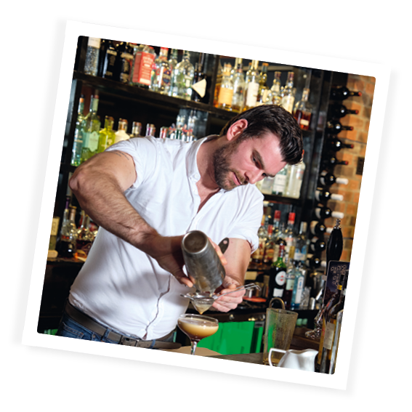
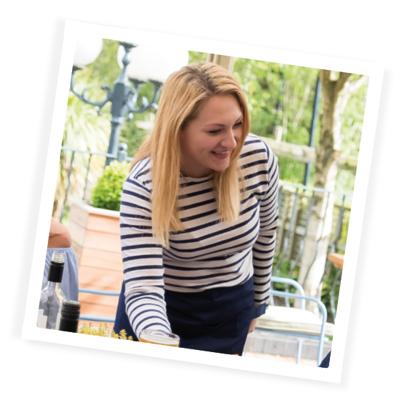
Our Purpose
Everything we do should centre around delivering our purpose:
Making people feel at ease… through our real hospitality delivered in a socially responsible way by friendly faces in our outstanding properties in great locations.
What does making people feel at ease mean to you?
Notes:
Here at Daniel Thwaites, our history and heritage, craftsmanship and tradition go hand in hand and bring together our real family hospitality.
We want to make people feel at ease – this is our company purpose.
Making people feel at ease… through our real hospitality delivered in a socially responsible way by friendly faces in our outstanding properties in great locations.
Everything we do should help contribute towards our purpose.
It doesn’t matter whether you serve customers/guests in property or work in Head Office, every single one of us can impact the customer/guest experience through the work we do and we all have a role to play in that.
We want our team members to be the best they can be so that through their skill, commitment and passion for doing what they do best, they deliver amazing experiences for all our guests.
What does making people feel at ease mean to you?
It might be smiling to colleagues and guests in the corridor, offering to carry someone’s bags or finding our guests a nice cosy spot to sit at in front of the fire with a mug of tea at one of our outstanding properties.

Slide 16

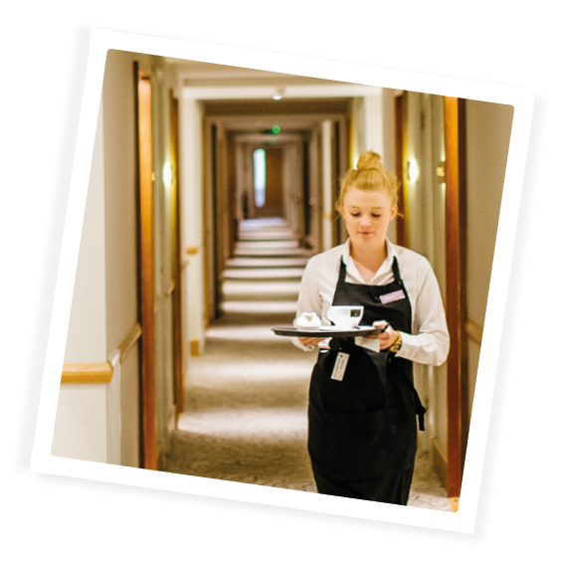
An eye for quality…
We endeavour to be the best by providing first class products and services, outshining the competition with meticulous attention to detail
We deliver this service consistently, with love and passion
We maintain high standards, always challenging ourselves to be better
An Example: Introducing a department walk round at the start of shift to ensure that everything looks fantastic for our guests.
Notes:
Daniel Thwaites had only four principles in mind whilst curating his brewery empire. Four principles that would undeniably stand the test of time… Put simply, the Daniel Thwaites principles are at the heart of how we do things at work every day.
(Manager to provide an example of how they have demonstrated one of the principles)

Slide 17
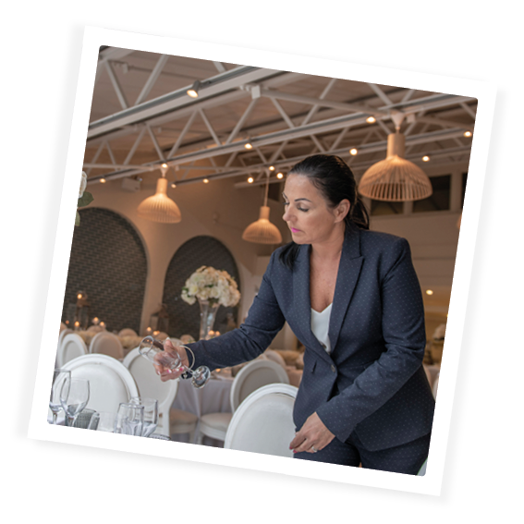
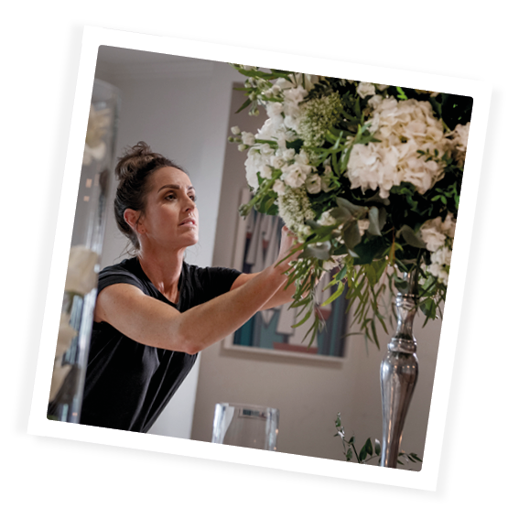
A generous blend of innovation…
We endeavour to stand out from the rest and inspire creativity
We do this by staying ahead of trends, being adventurous, trying new things and not being afraid to make mistakes
We celebrate individuality, entrepreneurial sprit and brave thinking, helping us develop and move forward.
An Example: Doing some research on new seasonal trends to help develop our specials on the menu, or finding a local supplier we can start to work with who can offer something different to our offer in the property.
Notes:
Daniel Thwaites had only four principles in mind whilst curating his brewing empire. Four principles that would undeniably stand the test of time… Put simply, the Daniel Thwaites principles are at the heart of how we do things at work every day.
(Manager to provide an example of how they have demonstrated one of the principles)

Slide 18
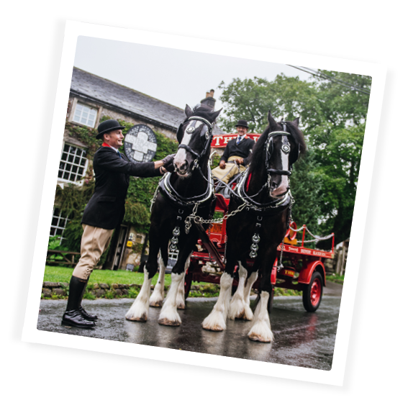
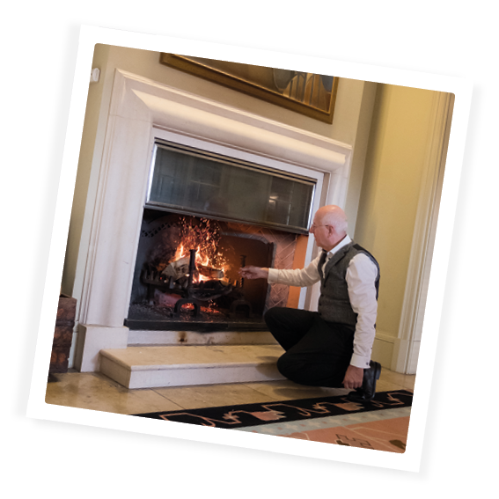
The most accurate of craftsmanship…
We endeavour to bring skill and expertise to everything we do and will not compromise.
We deliver this by taking pride in our work, growing our talent and respecting our heritage
Our eye for detail and tenacity helps drive excellence and build trust in our brand
An Example: Explaining the special things about our lovely meals and drinks when serving guests at the table, e.g. it might be a special kind of pasta we have used, or a new gin that they are trying.
Notes:
Daniel Thwaites had only four principles in mind whilst curating his brewing empire. Four principles that would undeniably stand the test of time… Put simply, the Daniel Thwaites principles are at the heart of how we do things at work every day.
(Manager to provide an example of how they have demonstrated one of the principles)

Slide 19
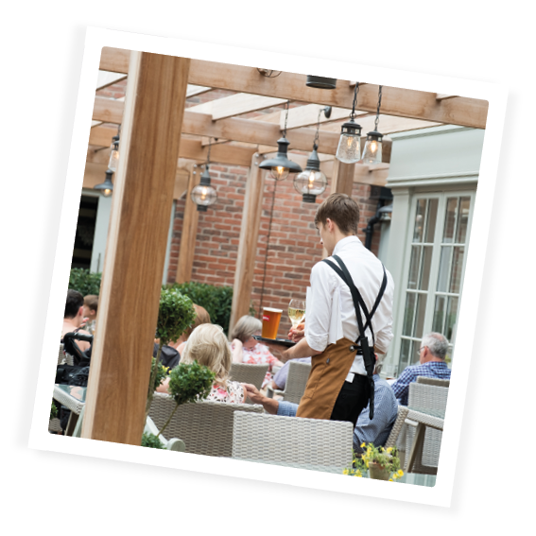
Lots of warm hospitality…
We endeavour to provide the warmest of welcomes and exceptional customer service, going the extra mile to create a unique experience
We do this be appreciating every customer is different, anticipating needs and exceeding expectations
Our service is honest and genuine, packed full of personality and delivered with a smile
An Example: Always using eye contact and saying hello and good bye, asking guests what they liked about their meal, HK offering them a huge smile in the corridor and making eye contact as they leave their room for a day out, telling them to have a fantastic day!
Notes:
Daniel Thwaites had only four principles in mind whilst curating his brewing empire. Four principles that would undeniably stand the test of time… Put simply, the Daniel Thwaites principles are at the heart of how we do things at work every day.
(Manager to provide an example of how they have demonstrated one of the principles)

Slide 20

We want our team members to have amazing experiences…
We will WELCOME you into our business
We will enable you to continue LEARNING
We will ask you to CONTRIBUTE everyday in your role
We will REWARD you for doing a great job
Together, WE ARE DANIEL THWAITES and welcome to our family!
Notes:
At Daniel Thwaites, we want our team members to have amazing experiences, we will continue to strive to welcome you in to the business, in to a fun environment so that you can deliver the best for our guests and each other, always going the extra mile to deliver a wonderfully warm and real experience.
And how will we make you feel all these things? We will WELCOME you in to the business and enable you to continue LEARNING and developing. We will ask that you CONTRIBUTE personally everyday in your role to enable us to deliver our purpose, and we will REWARD and recognise you for doing a great job, celebrating our successes together!
We want our team members to feel supported and cared for, proud, valued, motivated and engaged.
Q. How do you feel about starting work for Daniel Thwaites?
Q. What are you most looking forward to?
Q. Do you have any concerns?

Slide 21
Sickness and Absence procedure
If you are unwell and/or unable to attend work. The following procedure must be followed :-
Call the manager on duty
This call should be made no later than 1 hours before your shift is due to start
Calls must be made for each day that is required off (unless you are covered by a GP fit note)
After 7 days of absence, you must supply a GP fit note for any further days of absence
On your return to work you will be required to complete a self certification form (for absences up to 7 days)
You will also be required to attend a Return to work meeting with your manager when you return
Variable workers : no obligation to offer work or for worker to accept, however where work is declined over 3+ occasions or worker becomes inactive they will be removed from the database.

Slide 22
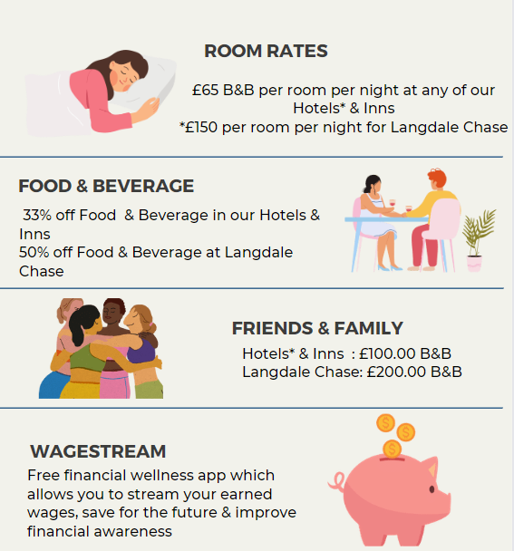
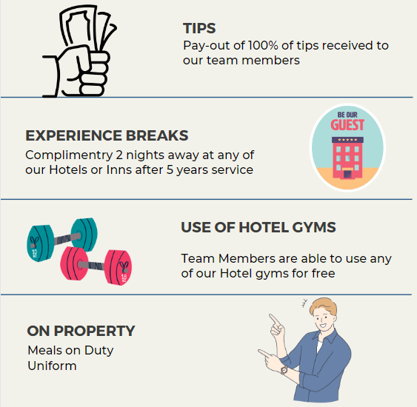
Company Benefits

Slide 23
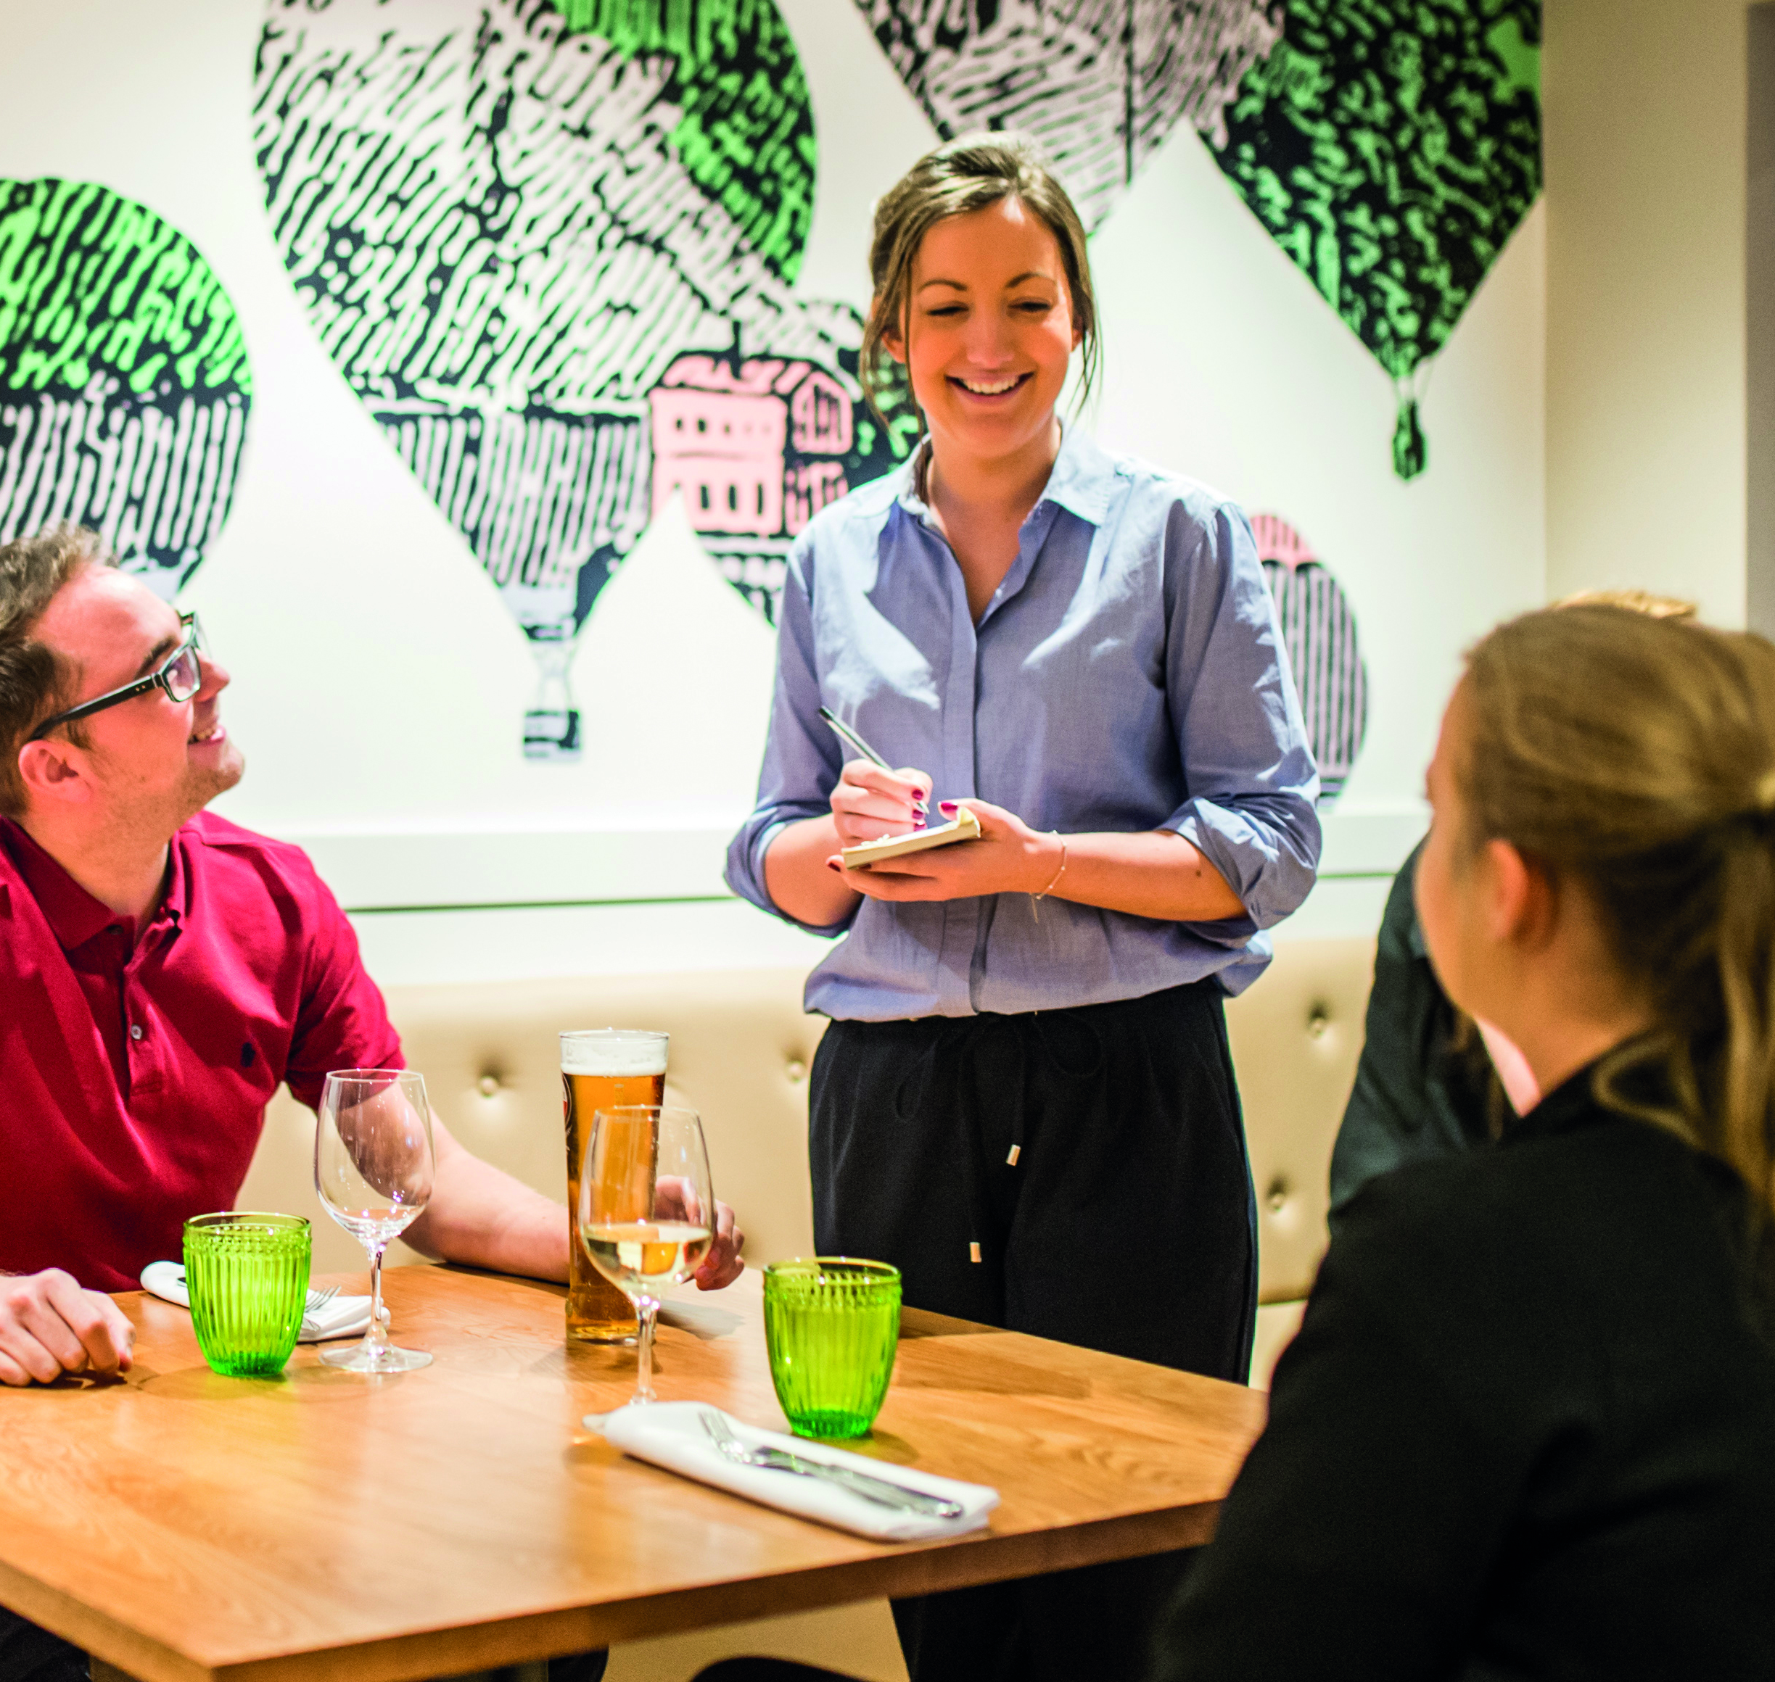
Company Benefits Continued…
Enhanced Holidays
Enhanced Paternity Leave
Enhanced Maternity Leave
Health Shield Pension
Life Insurance
Drinks Discount
Cycle to Work Scheme
Service Awards
Notes:
Talk through each of the benefits

Slide 24

Employee Assistance Programme
24/7 Counselling & Support Headline
Health Shield helpline can offer practical information and emotional support for issues relating to:
Family
Bereavement
Medical Information
Money Management
Addiction Support
Debt Support
Counselling
Tel: 0800 028 1963
(Available to you, your partner & Dependents over 16)
Notes:
Please don’t forget about our Employee Assistant Programme.
The helpline is available to you, your partner and dependants over the age of 16 (if covered). Just call 0800 028 1963 and quote your company name. My 24/7 Counselling and Support Helpline is provided on behalf of Health Shield by Health Assured.
HEALTH SHIELD CASH PLAN SCHEME – is our Company sponsored cash plan which is provided free of charge at cashback level 1
Ability to claim back a proportion of everyday health expenses, such as prescriptions, dental, optical, physiotherapy.
Hourly Paid team members are eligible after 2 years’ service.
Salaried team members are eligible from start date.
Details of your cover and how to make a claim can be found by using your member number and logging onto the members area, www.healthshield.co.uk/members
Head Office administration contact payrollteam@thwaites.co.uk

Slide 25

My Daniel Thwaites Hub
Our App allows you access to your benefits, company policies, learning and development, payslip, book holidays and access your rota.
It is also where you will see the Thwaites newsfeed and be able to keep up to date with what’s happening within your location and across the company
We would love to hear any stories you have as you start your career and continue to build on it.
Notes:
We would love to hear any stories you have as you start your career and continue to build on it.
Please share your stories, photos and videos on our workplace page ‘We Are Daniel Thwaites’ showcasing what makes working for Daniel Thwaites so great

Slide 26
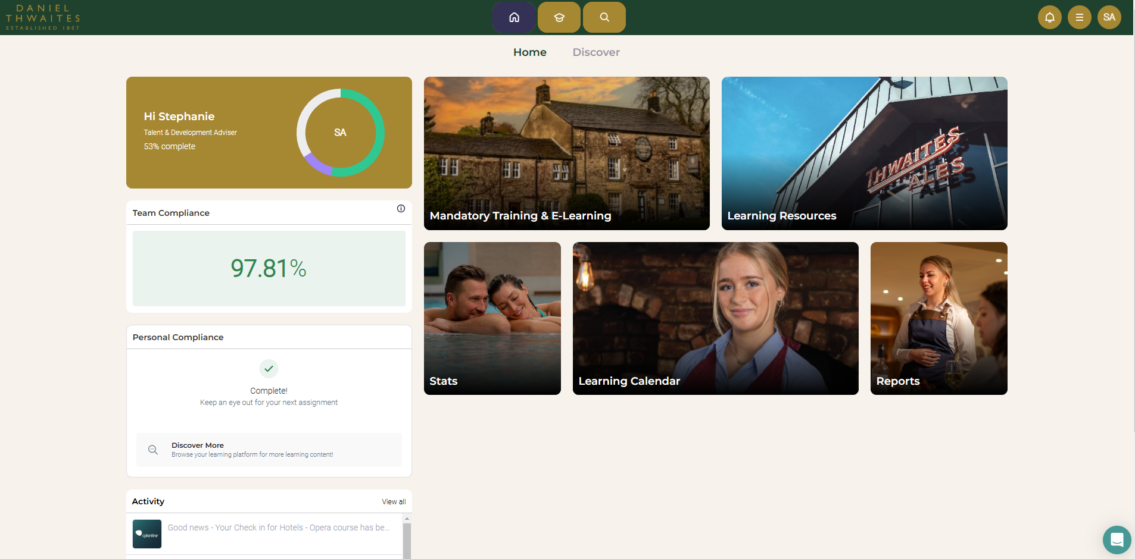
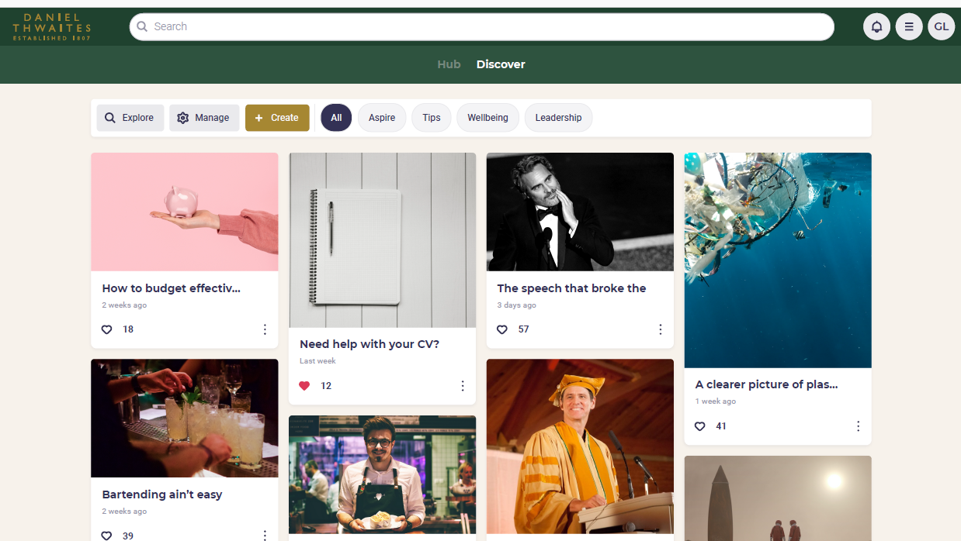
Campus
Campus is our learning and development platform where you can complete essential compliance training or explore a wide range of content for your personal and career development.
Accessed via My Daniel Thwaites Hub

