Slide 1
INTRODUCTION TO DANIEL THWAITES

Slide 2
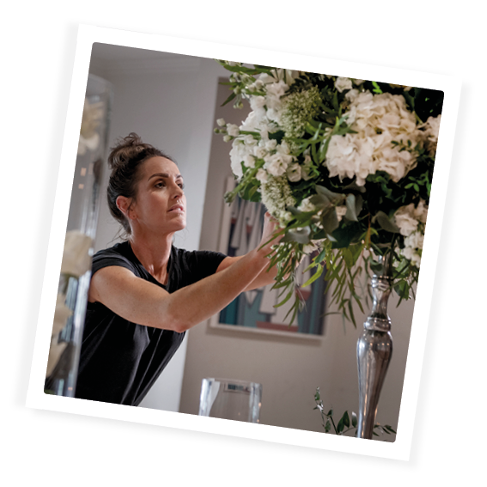
Line Manager Guidance:
Hello,
This presentation is designed to help you welcome your new team members into Daniel Thwaites on their first day. This includes information on:
-Who we are as a business & culture
-What makes us special and how they fit into the family.
-Overview of your property
-Employee Benefits & Incentives
This presentation will take approx. 60 minutes and we have provided a handy script/guide at the bottom of each slide to help you. Please feel free to personalise this by adding any other key messages & examples throughout.

Slide 3
Notes:
Start the induction with a welcome to the business and congratulation on being successful in the recruitment process
Include an icebreaker to get to know each other. Ask participants to introduce themselves
-Name
-Position/Department
-Previous Hospitality experience
-One interesting or fun fact about themselves

Slide 4
Notes:
Give an overview of what the induction will cover along with timings and housekeeping

Slide 6
Notes:
Our family is made up of many different parts, as you can see in our family tree.
(Talk through the family tree, using the guide on the right to help explain)
We are a team of 1800, our roots may be founded in Blackburn but we now stretch throughout England, from as far south as the Solent, to the Northern heights of Penrith and reaching across the land from sunny Blackpool to beautiful Beverley.
Our family involves a collection of 8 beautiful hotels and spas and 13 premium inns across the country, with teams working at each property to provide an amazing experience for our guests. Whether it be in housekeeping, reception, kitchen, maintenance, food and drink, bar, sales, social media, people or the spa, we really do have a talented bunch.
Are pubs are an important part of our business, and many of our landlords have run their pubs at the heart of their communities for years. They are supported by our Pub Operations team based from Head Office who help them to be the best that they can be, taking beer orders, generating new menu and drinks ideas and supporting their small businesses thrive. Our pub operations team also welcome two of our managed houses, The Flying Handbag in Blackpool and the Pendle Inn.
Brewing is in our blood, and our Brewery based in the Ribble Valley is home to our 5 brewers, passionate about their craft they have been brewing ales for us for years. In keeping with our tradition and heritage, we also have some very special members in our team, our shire horses who help share the Thwaites story at events up and down the country.
Our Inns, Hotels, Brewery and Pubs are all supported by our head office based in the Ribble Valley. We have teams including our Pub Operations, Finance & IT, Marketing, Estates and People, all passionate about helping improve our guests experience through the work they do.
Question: Can you describe how we fit into the Daniel Thwaites Family Tree?

Slide 7
Notes:
Our team members define us, and everyone has an important role to play in supporting our business. We are guided by our executive team who help us deliver business success. We asked them to share a few words of advice to help you to integrate into our business.
If you recognise any of these faces whilst at work, do say hello.. They are always happy to chat to our teams.

Slide 8
Notes:
Our Story
In a world that’s changing faster than ever, it’s comforting to know that that some things withstand the passage of time. It is over two centuries ago since Daniel Thwaites set out from his family’s Lake District farm to make a new life for himself, and the rest they say, is history.
Daniel built up his brewery based on strong family principles - an eye for quality and a generous blend of innovation, craftsmanship and warm hospitality. Who would have believed, six generations later, that his family would proudly continue the journey Daniel started and remain faithful to his principles - still striving for brewing perfection, now with our warm hospitality extending to a growing collection of pubs, inns, managed houses, hotels and spas.
Today, we are passionate about our traditional values but time certainly hasn’t stood still. We are always looking to adapt to a changing world and for ways to improve to ensure we give you an experience that’s second to none. Above all, we know that with Thwaites, from our broad family of craft brewers in Lancashire, to our shire horses – still pulling their traditional drays, to our team members in properties up and down Britain, no matter where our guests choose to visit us, we will always guarantee a warm welcome from a friendly face.

Slide 13
Notes:
Our family is made up of many different parts, as you can see in our family tree.
(Talk through the family tree, using the guide on the right to help explain)
We are a team of 1400, our roots may be founded in Blackburn but we now stretch throughout England, from as far south as the Solent, to the Northern heights of Penrith and reaching across the land from sunny Blackpool to beautiful Beverley.
Our family involves a collection of 8 beautiful hotels and spas and 11 premium inns across the country, with teams working at each property to provide an amazing experience for our guests. Whether it be in housekeeping, reception, kitchen, maintenance, food and drink, bar, sales, social media, people or the spa, we really do have a talented bunch.
Are pubs are an important part of our business, and many of our landlords have run their pubs at the heart of their communities for years. They are supported by our Pub Operations team based from Head Office who help them to be the best that they can be, taking beer orders, generating new menu and drinks ideas and supporting their small businesses thrive. Our pub operations team also welcome two of our managed houses, The Flying Handbag in Blackpool and the Pendle Inn.
Brewing is in our blood, and our Brewery based in the Ribble Valley is home to our 5 brewers, passionate about their craft they have been brewing ales for us for years. In keeping with our tradition and heritage, we also have some very special members in our team, our shire horses who help share the Thwaites story at events up and down the country.
Our Inns, Hotels, Brewery and Pubs are all supported by our head office based in the Ribble Valley. We have teams including our Pub Operations, Finance & IT, Marketing, Estates and People, all passionate about helping improve our guests experience through the work they do.
Question: Can you describe how we fit into the Daniel Thwaites Family Tree?

Slide 14
Notes:
Our team members define us, and everyone has an important role to play in supporting our business. We are guided by our executive board who help us deliver business success….. We asked them to share with you a little more about their role and their advice for you in your first few days at Daniel Thwaites.
If you recognise any of these faces whilst at work, do say hello.. They are always happy to chat to our teams.

Slide 15
Notes:
Our team members define us, and everyone has an important role to play in supporting our business. We are guided by our executive board who help us deliver business success….. We asked them to share with you a little more about their role and their advice for you in your first few days at Daniel Thwaites.
If you recognise any of these faces whilst at work, do say hello.. They are always happy to chat to our teams.

Slide 16
INSERT
GM PICTURE
Insert Text
Welcome from General Manager

Slide 17
Hotel Senior Leadership Team/Inns Management Team
*Delete as appropriate*
Name
Title
Fun Fact
Name
Title
Fun Fact
Name
Title
Fun Fact
Name
Title
Fun Fact
Name
Title
Fun Fact
Name
Title
Fun Fact
Jason Royal
People & Development Director
Welcome to Daniel Thwaites. We want you to bring your true self to work every day and use your personality to help provide amazing experiences for our guests, whether that be working in one of our beautiful properties or supporting from the Centre.
Hospitality is exciting and rewarding in many ways and with us, you will have access to some great personal development and career opportunities. We also have fantastic benefits for you to enjoy and we really encourage you to make full use of them!
Notes:
HOTELS- Add in pictures of Senior Leadership Team
INNS – Add pictures of Inns Management Team

Slide 18
Notes:
Here at Daniel Thwaites, our history and heritage, craftsmanship and tradition go hand in hand and bring together our real family hospitality.
We want to make people feel at ease – this is our company purpose.
Making people feel at ease… through our real hospitality delivered in a socially responsible way by friendly faces in our outstanding properties in great locations.
Everything we do should help contribute towards our purpose.
It doesn’t matter whether you serve customers/guests in property or work in Head Office, every single one of us can impact the customer/guest experience through the work we do and we all have a role to play in that.
We want our team members to be the best they can be so that through their skill, commitment and passion for doing what they do best, they deliver amazing experiences for all our guests.
What does making people feel at ease mean to you?
It might be smiling to colleagues and guests in the corridor, offering to carry someone’s bags or finding our guests a nice cosy spot to sit at in front of the fire with a mug of tea at one of our outstanding properties.

Slide 19
Notes:
Daniel Thwaites had only four principles in mind whilst curating his brewery empire. Four principles that would undeniably stand the test of time… Put simply, the Daniel Thwaites principles are at the heart of how we do things at work every day.
(Manager to provide an example of how they have demonstrated one of the principles)

Slide 20
Notes:
Daniel Thwaites had only four principles in mind whilst curating his brewing empire. Four principles that would undeniably stand the test of time… Put simply, the Daniel Thwaites principles are at the heart of how we do things at work every day.
(Manager to provide an example of how they have demonstrated one of the principles)

Slide 21
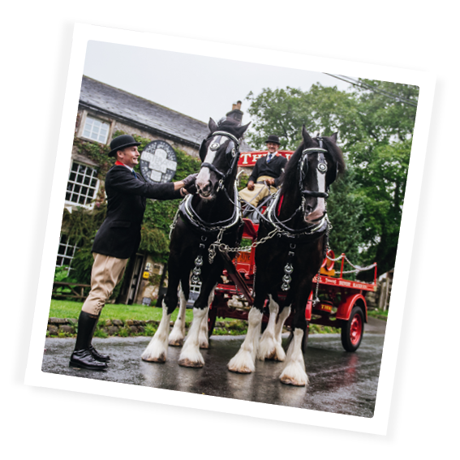
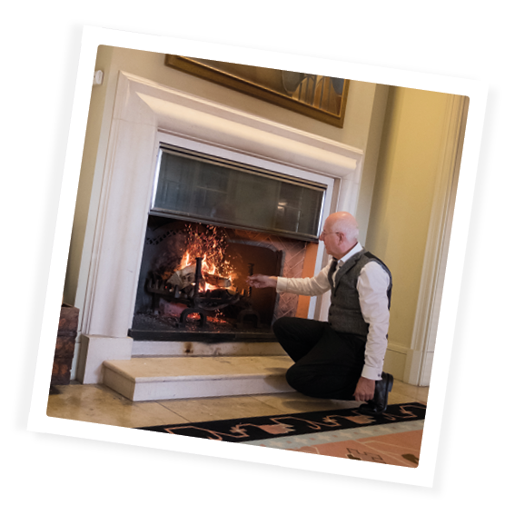
The most accurate of craftsmanship…
We endeavour to bring skill and expertise to everything we do and will not compromise.
We deliver this by taking pride in our work, growing our talent and respecting our heritage
Our eye for detail and tenacity helps drive excellence and build trust in our brand
An Example: Explaining the special things about our lovely meals and drinks when serving guests at the table, e.g. it might be a special kind of pasta we have used, or a new gin that they are trying.
Notes:
Daniel Thwaites had only four principles in mind whilst curating his brewing empire. Four principles that would undeniably stand the test of time… Put simply, the Daniel Thwaites principles are at the heart of how we do things at work every day.
(Manager to provide an example of how they have demonstrated one of the principles)

Slide 22
Notes:
Daniel Thwaites had only four principles in mind whilst curating his brewing empire. Four principles that would undeniably stand the test of time… Put simply, the Daniel Thwaites principles are at the heart of how we do things at work every day.
(Manager to provide an example of how they have demonstrated one of the principles)

Slide 23
Notes:
At Daniel Thwaites, we want our team members to have amazing experiences, we will continue to strive to welcome you in to the business, in to a fun environment so that you can deliver the best for our guests and each other, always going the extra mile to deliver a wonderfully warm and real experience.
And how will we make you feel all these things? We will WELCOME you in to the business and enable you to continue LEARNING and developing. We will ask that you CONTRIBUTE personally everyday in your role to enable us to deliver our purpose, and we will REWARD and recognise you for doing a great job, celebrating our successes together!
We want our team members to feel supported and cared for, proud, valued, motivated and engaged.
Q. How do you feel about starting work for Daniel Thwaites?
Q. What are you most looking forward to?
Q. Do you have any concerns?

Slide 25
About us …
Insert Property Name
303 Deansgate, Manchester, M3 4LQ
**Add details & photo of your property**
Examples:
No of bedrooms
Facilities & Opening Times
Property History
Follow us…
Notes:
Insert Picture of property

Slide 26
Team Member Information
What you need to know ….
**Add/Delate as Appropriate***
Enter building via
Clocking in & out process
Team changing facilities
Breaks & Staff Food
Holidays & Fourth
Pay
The Hub
Uniform
THRIVE ZONE

Slide 27
Sickness and Absence procedure
If you are unwell and/or unable to attend work. The following procedure must be followed :-
Call the manager on duty on *****
This call should be made no later than 1 hours before your shift is due to start
Calls must be made for each day that is required off (unless you are covered by a GP fit note)
After 7 days of absence, you must supply a GP fit note for any further days of absence
On your return to work you will be required to complete a self certification form (for absences up to 7 days)
You will also be required to attend a Return to work meeting with your manager when you return
Variable workers : no obligation to offer work or for worker to accept, however where work is declined over 3+ occasions or worker becomes inactive they will be removed from the database.

Slide 29
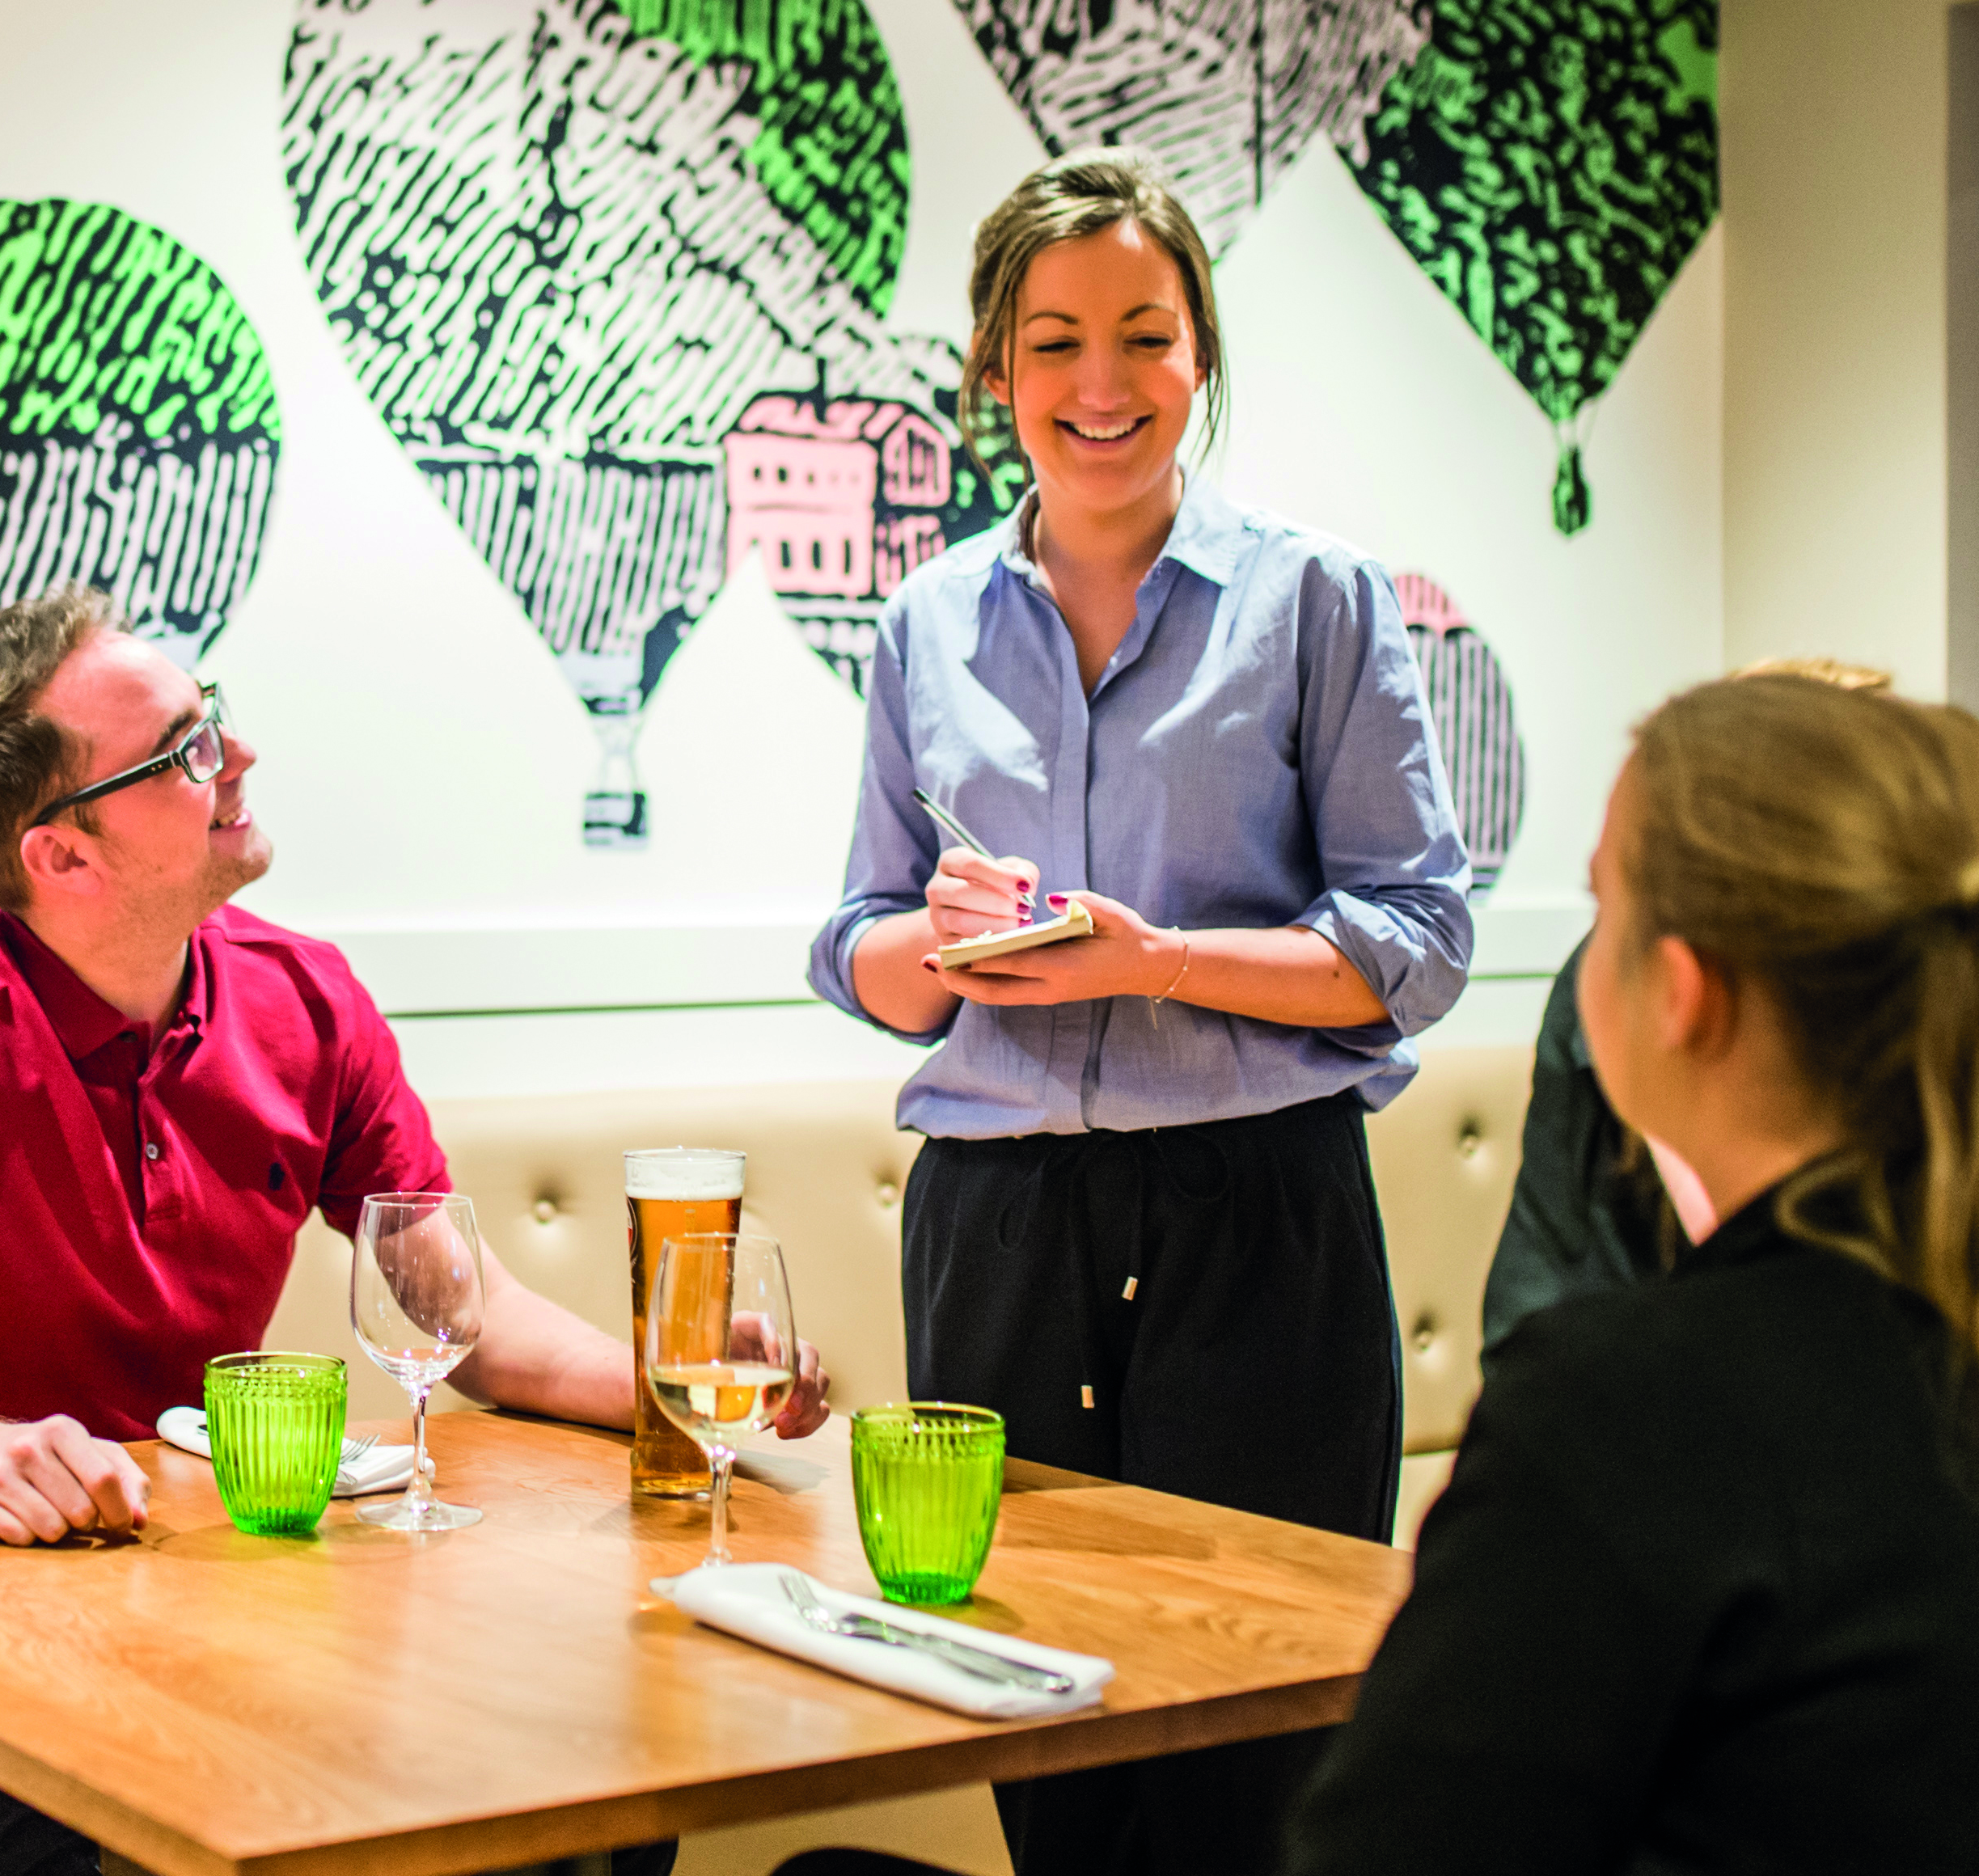
Company Benefits Continued…
Enhanced Holidays
Enhanced Paternity Leave
Enhanced Maternity Leave
Health Shield Pension
Life Insurance
Drinks Discount
Cycle to Work Scheme
Service Awards
Employee Voice
Employee of the Month
***Delete as appropriate***
Notes:
Talk through each of the benefits

Slide 30
Notes:
Please don’t forget about our Employee Assistant Programme.
The helpline is available to you, your partner and dependants over the age of 16 (if covered). Just call 0800 028 1963 and quote your company name. My 24/7 Counselling and Support Helpline is provided on behalf of Health Shield by Health Assured.
HEALTH SHIELD CASH PLAN SCHEME – is our Company sponsored cash plan which is provided free of charge at cashback level 1
Ability to claim back a proportion of everyday health expenses, such as prescriptions, dental, optical, physiotherapy.
Hourly Paid team members are eligible after 2 years’ service.
Salaried team members are eligible from start date.
Details of your cover and how to make a claim can be found by using your member number and logging onto the members area, www.healthshield.co.uk/members
Head Office administration contact payrollteam@thwaites.co.uk

Slide 31
Notes:
We would love to hear any stories you have as you start your career and continue to build on it.
Please share your stories, photos and videos on our workplace page ‘We Are Daniel Thwaites’ showcasing what makes working for Daniel Thwaites so great

