Slide 1


My Daniel Thwaites Hub User Guide

Slide 2

My Daniel Thwaites Hub: Introduction
The Benefit of My Daniel Thwaites Hub
My Daniel Thwaites Hub gives you an app where you can access our Company Newsfeed, your personal and work details and your Schedules. You can also gain access to your benefits such as Wagestream and Campus, our learning and development app.
My Daniel Thwaites Hub app is available for free download from the Apple business and Android app stores. Alternatively, it can be accessed via desktop or laptop computer by using https://secure.fourth.com/
Regardless of how My Daniel Thwaites Hub is accessed, the functionality remains the same.

Slide 3
Who Can Post Content
Anyone can post content, but it is important that internal champions are identified who will regularly post content to the relevant groups and remind team members to review it often.
Managers within the business should understand how they can use My Daniel Thwaites Hub to communicate effectively, including adding images or videos.
Some Company/property specific content will be posted by the following groups;
We are Daniel Thwaites
For sharing news and information about the business
People Team
Will use announcements for updates and changes, such as; New or updated policies and benefits, internal vacancies or sharing results and actions from satisfaction surveys and competitions
General Managers / HR Admin
To communicate results, customer feedback, team member recognition, new menus, etc.
Making one post to a Location Group ensures that every team member will receive the post in their feed, keeping them up to.
Payroll To send reminders to all team members or groups, such as changes to the usual pay date (e.g. Christmas), payroll and expenses cut off dates.

Slide 4
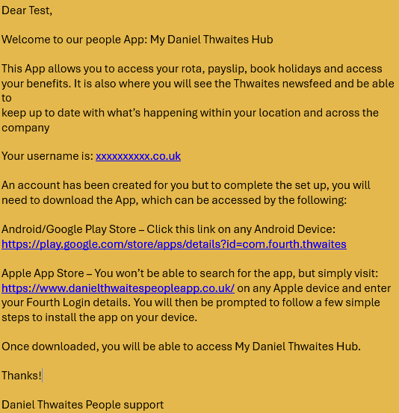
Access, Welcome and Activation Email
When your Fourth Account is activated, you will receive two emails to set up your account:
First use the activation link which will prompt you to create a new password and accept the Terms & Conditions.
Second will be a welcome email similar to this example. This will advise you of your Username and has a link to download the app.
Please note: The activation link expires in 7 days.
If the link has expired, still use the link, you will be directed to the login page and select ‘Forgotten password?’.

Slide 5
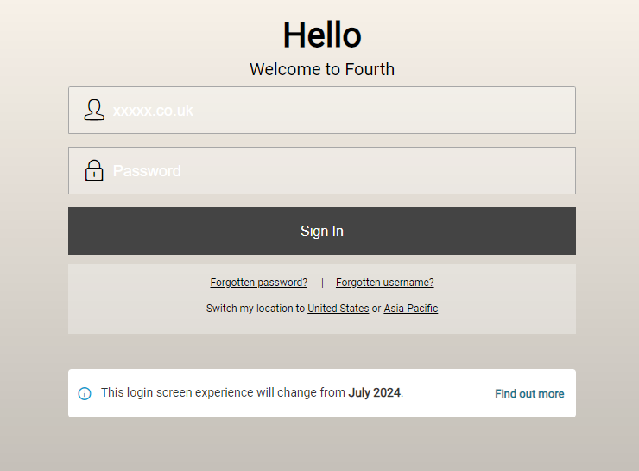
Signing In to My Daniel Thwaites Hub
On your mobile device, open the My Daniel Thwaites Hub app
On your web browser, go to https://secure.fourth.com/
Log in using your Username (personal email) and Password created on first login

Slide 6
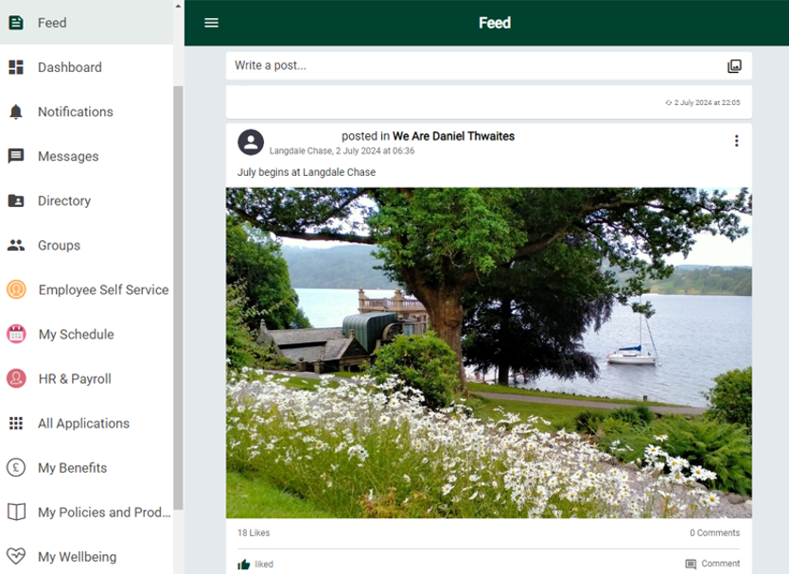
News Feed
When you log into My Daniel Thwaites Hub the Feed screen will appear. This is our newsfeed and displays posts that have been made by colleagues within the organisation.
You can like, comment and reply to posts, as well as creating your own.
Typically posts will contain information on day-to-day events in the Company or your Property.
You will see posts that have been made in all Groups that you are a member of.

Slide 7
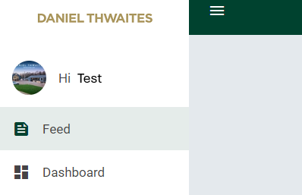
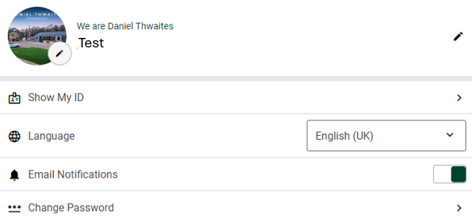
Personalise Your Profile
On your Feed page select the hamburger menu icon
Select Hi Test
Username – If you would like to change your username from your personal email, select the pencil icon on the right. Create a new Username and save changes. This will become your username when logging in.
Preferred Name – Can be changed to the name you prefer to be known by
About me – Can be used to let colleagues know a little more about you
Profile Picture – To add your photo or a picture.
On a laptop choose a saved photo.
On a mobile device take a photo or choose a saved one.
Show My ID shows your employee number
Language - can be changed to one from the drop box
Email Notifications – can be toggled on to receive notifications (recommended)
Change Password – to amend your password

Slide 8
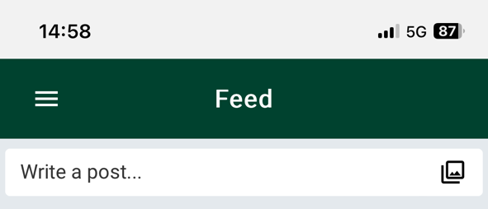
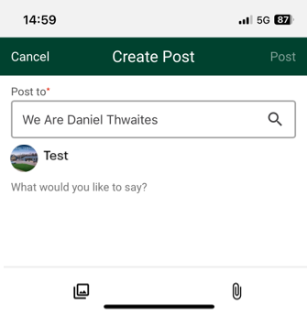
Creating Posts
Posts are created on the Feed screen.
You can post in a Group (provided you are member of that Group), or to the wider business community.
Always check which group you are posting to, so your message reaches the correct team members. Once a post has been made, it will appear at the top of your Feed for all members of that Group to see.
You can like, comment or add an emoji to your post if you wish as on a social media platform. (see Likes & Comments page)
Likes and comments will keep your post 'bumped' to the top of the Feed.
It’s possible to mention colleagues in a post, using the '@' symbol then start to type their name. The list will appear on a desktop as you start to type their name, whilst on a mobile device, start to type their name and scroll up for the list to appear. The colleague mentioned will then receive a notification. Files and images can be attached to posts by using the photo and paperclip options at the bottom of the Create Post page. If a URL is included in a post's text, it will display as a clickable link.
NOTE - if using a photo saved on your device the app will need to be given access to your photos in device settings.

Slide 9
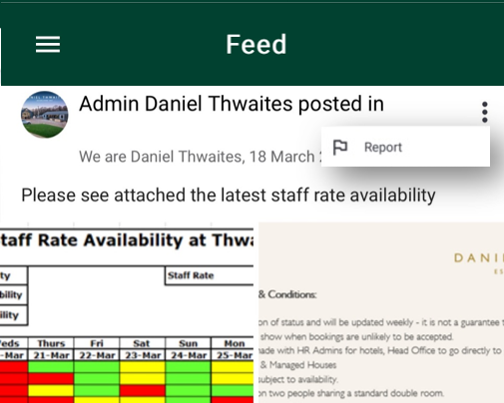
Reporting a Post
Occasionally there could be a post that has detail or comments that are unsuitable for a Company newsfeed, or you believe may not be appropriate. If this happens the post can be reported by selecting the three dots at the top right of the post, a report box will open, click to report
The post will be removed immediately and sent to the Company moderator to review

Slide 10
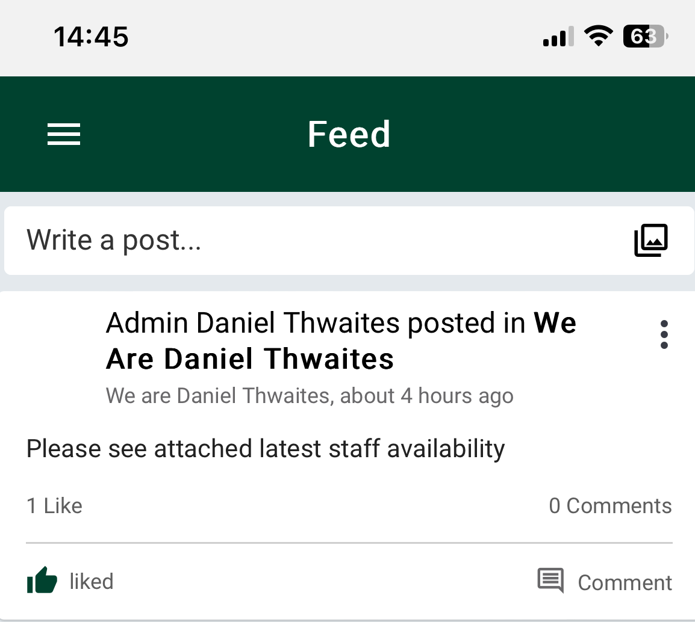



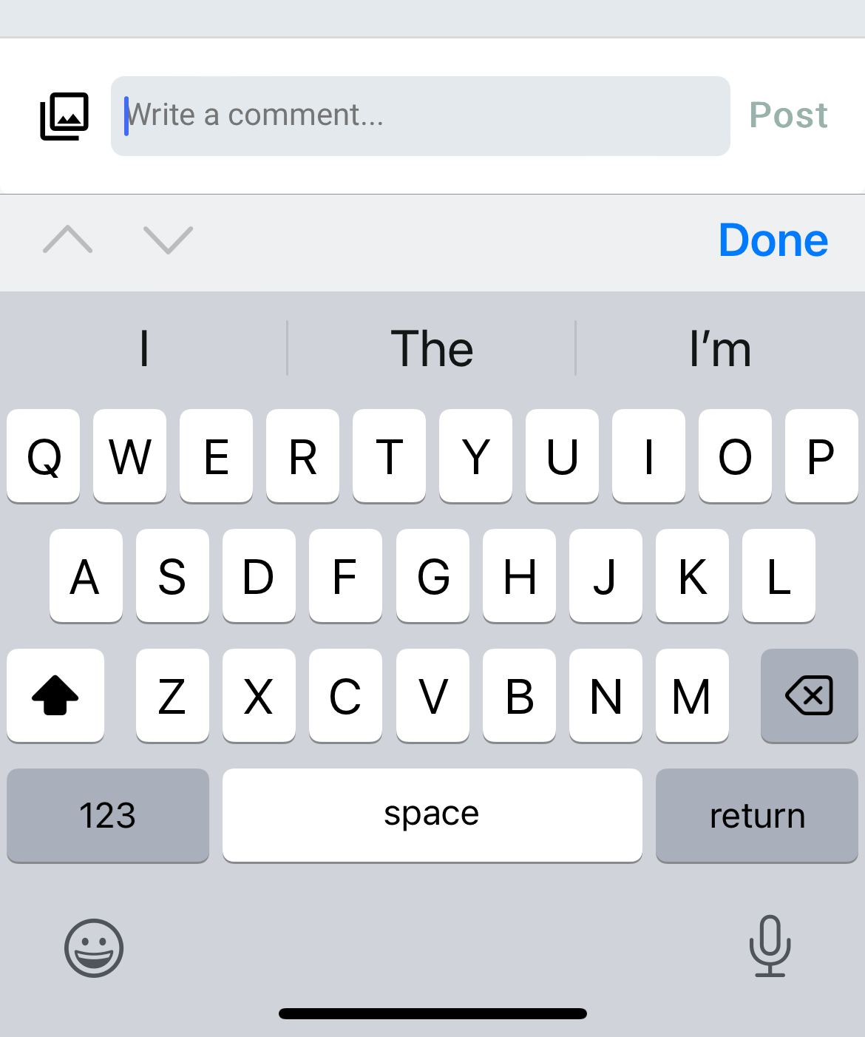
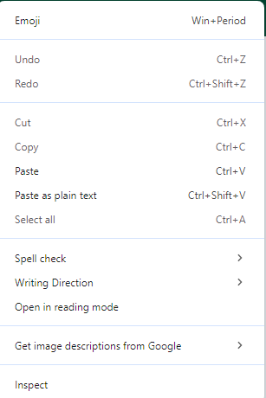
Likes & Comments
You can like or comment on posts in your feed
To like a post
Click on the like symbol. This will turn green to show it has been liked
To add an emoji
On your device click on the comment symbol to open the comment box
On a mobile device the emoji symbol will appear on your keyboard
On a desktop right click on the mouse or keypad in the comment box, a menu will open with the emoji option at the top
To tag in a colleague to a comment
Use the '@' symbol then start to type their name. The list will appear on a desktop as you start to type their name, whilst on a mobile device, start to type their name and scroll up for the list to appear. The colleague mentioned will then receive a notification

Slide 11
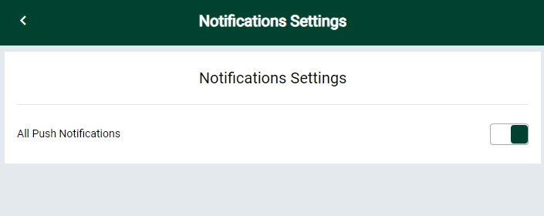
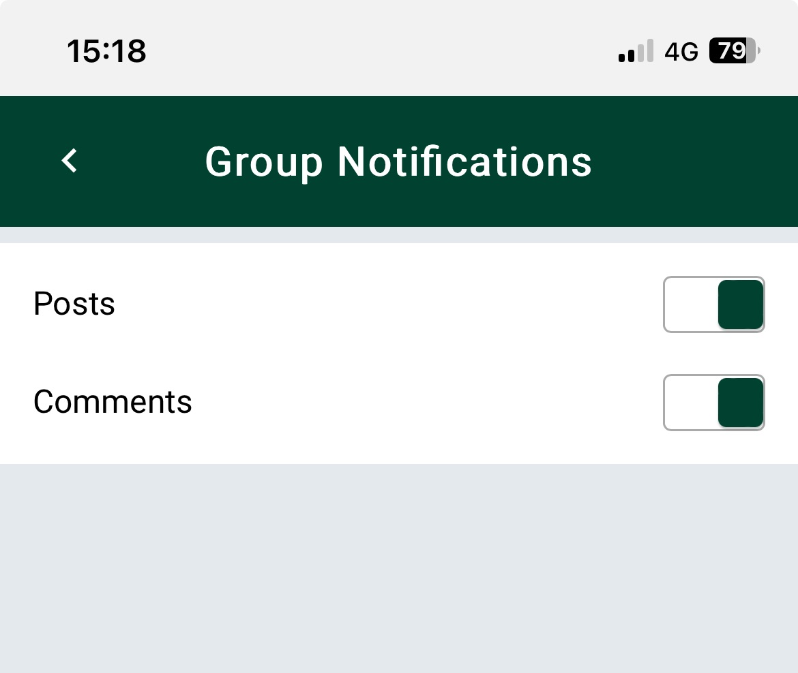
Notification Settings
We recommend notifications are switched on to ensure you receive all relevant information and news.
Notification Settings allows you to receive notifications from the groups you are a member of. By selecting notifications from your feed menu all push notifications can be turned on for your App
You will then receive notifications for events such as:
If a post is 'liked' or commented on
If a colleague is mentioned in a post or comment
A company-wide post/announcement is made
Notifications within a Group can be turned on to follow activity in that Group
Click on a group you are a member of, choose the icon below the location picture
Select notifications
NOTE – Team members who have left the Company and been switched over to a ‘Leavers’ Profile on Fourth will no longer receive any In-App or Push notifications for activities in groups after their leave date.

Slide 12
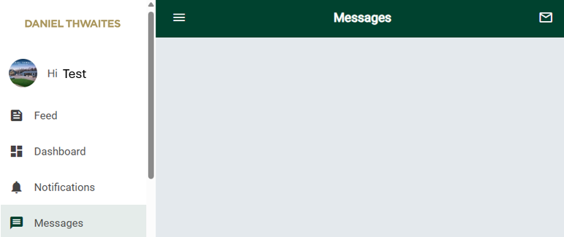
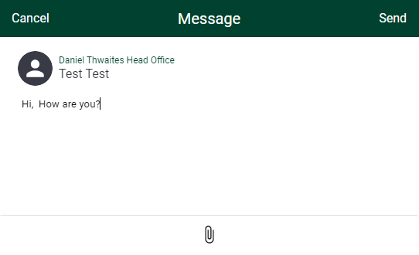
Messages
To send a Message to a colleague
Select Messages
Click the envelope icon in the right-hand corner
Begin typing their name in the search box then press the arrow next to their name when it appears
Type your message, attach any photos or video and press send
Receiving Messages
A green circle will show against your Messages icon if you have been sent a messages
You will receive a push notification on your mobile if these are turned on
NOTE – Notifications must be turned on in your app and group settings to get notifications when you receive a message. Team members are encouraged to switch notifications on, so they don’t miss out on updates and news.

Slide 13
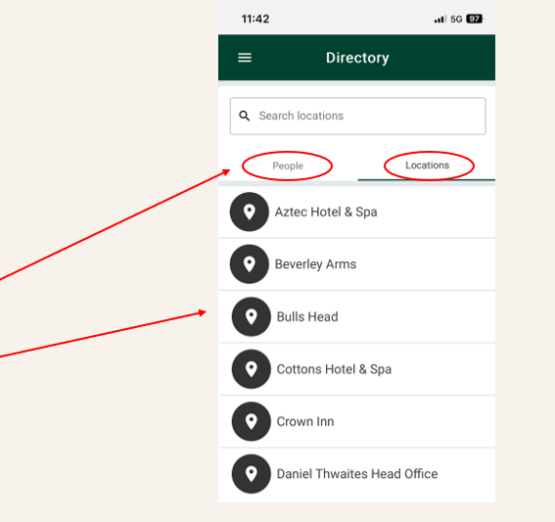
Directory
The Directory allows you to search for other team members either by name in the People section or by selecting their Location
People
Locations

Slide 14
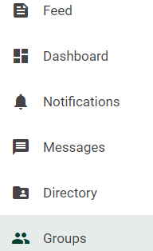
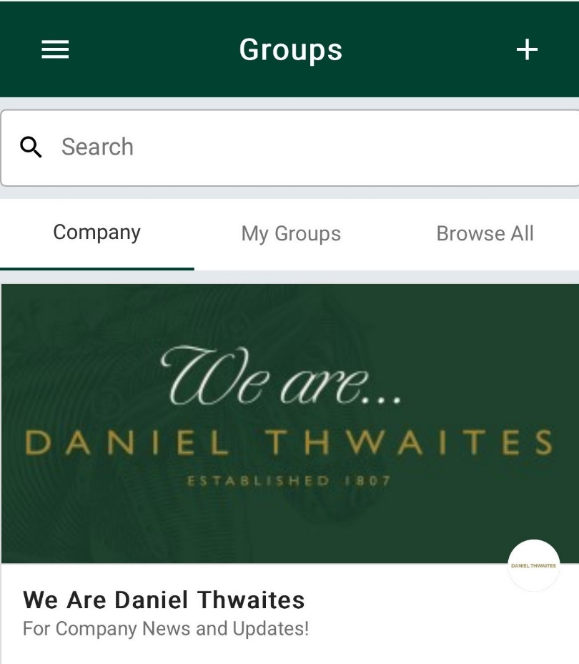
Groups
You will automatically be a member of We are Daniel Thwaites and your property group.
Select the Groups option from your menu bar
My Groups – will show all groups that you are a member of
Browse All - to join a group select the group you would like to join and press Request to Join, the group admin will then accept or decline your request
You can also create custom Groups within My Daniel Thwaites Hub
Select the + icon in the right-hand corner
Name your group and give a brief description of its purpose. The creator of the group will become the group administrator.
Groups can be set as either public (anyone can view and join) or private (anyone can see the Group, but the group administrator approves new members)
NOTE – Only work-related groups should be created by you, any content should be work appropriate.

Slide 15
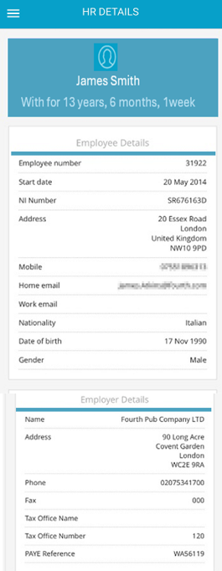
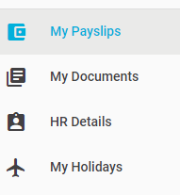
Employee Self Service
Using the Hamburger menu at the top of HR details page, you can access the following:
My Payslips - shows your payslips, net pay, and the option to download your payslip
My Documents – shows payslips, P60s and auto-enrolment pension letters
HR Details - shows your Personal, Employer and Employment details
My Holidays – shows your taken and requested holidays. Holidays can be requested using the plus symbol on your My Holiday page, selecting the dates you want to book and then apply. A notification of your request will be sent to your line manager for authorisation.

Slide 16
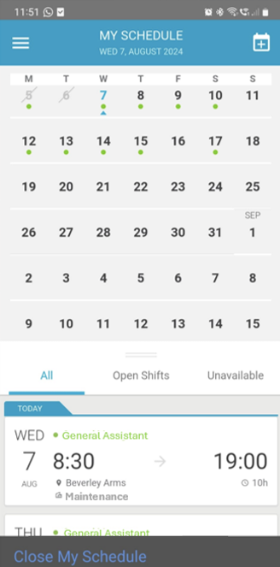
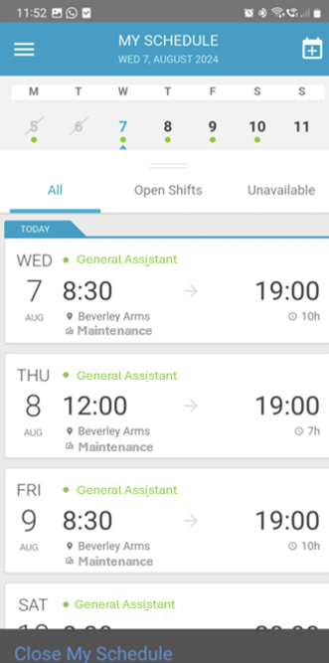
My Schedule
My Schedules - Shows your current and future schedules

Slide 17
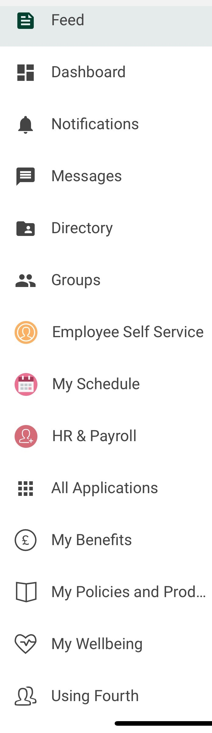
Additional Menu Options
Further options are displayed on your feed menu
HR & Payroll - will only show if you require this access for your job role
All Applications – will show all connected applications (i.e. Campus, Wagestream)
My Benefits – access to your Company Benefits information
My Policies & Procedures – access to Company Policies
My Wellbeing – access to your Wellbeing benefits and support
Using Fourth – ‘How to’ guides and videos on how to use features within the app

Slide 18
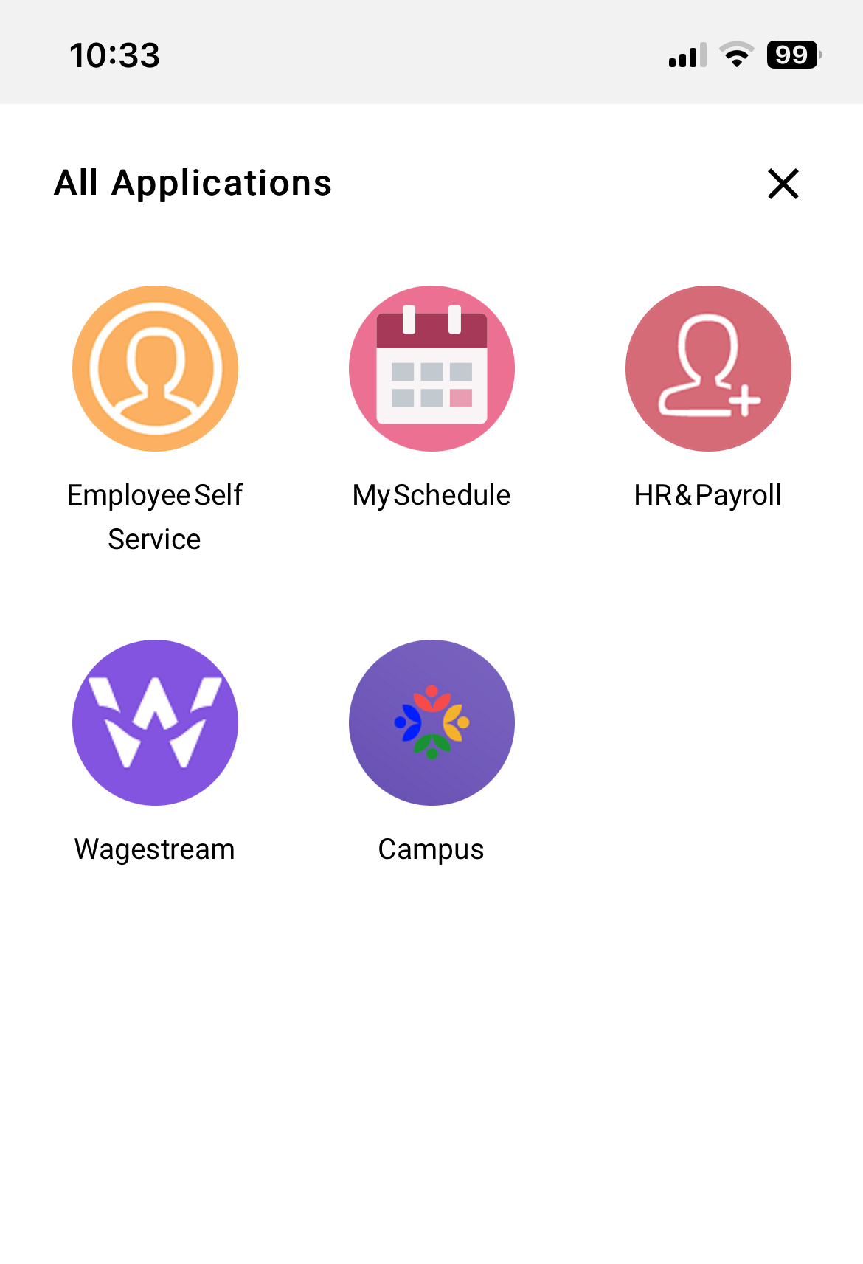
All Applications
Single Sign-On (SSO) gives you access to Company news, information and your employment details in one app.
Employee Self Service (ESS) gives you access to your personal details, payslip, holiday request, etc.
MySchedules gives you access to scheduled shifts
HR & Payroll to go to your Fourth solution, dependant on job role requirements (will open in a browser view - not advised for mobile devices)
Wagestream to access saving, discounts and to stream against your earned pay
Campus gives you easy access to your online learning

Slide 19
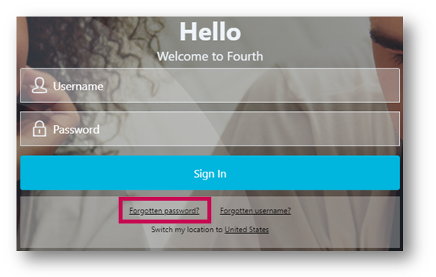
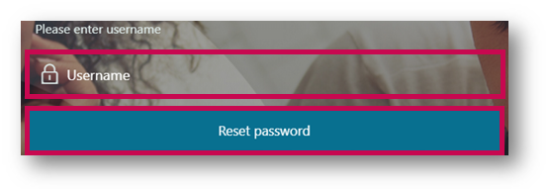
Forgotten Passwords
To reset a forgotten password, go to your login page and select Forgotten password?
Enter your personal email address or username if you have created a different one and select Reset password
An email will be sent to your personal email address, containing a link to create a new password. Please note passwords can only be change once in a 24-hour period.

Slide 20
FAQ’s
Q: Can we have the feed on our browser as we did with Workplace?
A: Unfortunately not, as it does not comply with GDPR due to having access to much more personal information.
Q: Can I change the language?
A: Yes, there are several options on the personalise your profile option drop box.
Q: I have dyslexia can I change the colour?
A: This will be a setting in the accessibility option on your device.
Q: Can I do a poll?
A: There is no functionality for this currently.
Q: I can’t make calls on it like I could on Workplace?
A: Due to GDPR contact numbers aren’t available.
Q: Can I search the feed to people and topic?
A: There is no search functionality on your feed screen currently.
Q: My App won’t open?
A: Make sure any browser sessions already open on your device are closed down fully. E.g. On iPhone swipe up and close your sessions.
Q: What if My Daniel Thwaites Hub shows my old employer details
A: Delete your app and reinstall using the Welcome email sent by Daniel Thwaites.
Q: I can’t download the app on my phone?
A: Some older phones may not have the capacity to download our app, but you can access via a computer browser.
Q: Where do I go for help?
A: Contact payrollteam@thwaites.co.uk in the first instance.
Q: The posts are out of date order?
A: The more comments and likes a post receives will move it closer to the top, so it wont always display in date order.
Q: I can’t see my old shifts?
A: Shifts can be seen for 2 weeks in arrears and 2 weeks in front.
Q: My shift has changed but the app is wrong?
A: When a manager changes a shift, they republish your rota which will update your app, or the shifts will automatically be updated at 1pm each day.
Q: A team member doesn’t have an email address. Can they still access the Fourth app? A: All team members will require an email address.
Q: How can a team member be given access to Fourth? A: Team members automatically receive a Welcome email for the Fourth Platform as soon as they are created within Fourth. A new Welcome email can be sent by contacting payrollteam@thwaites.co.uk.

Slide 21
FAQ’s
Q: How can a team member access the Fourth app? A: The Fourth app can be accessed by downloading the app using a welcome email or at http://secure.fourth.com via any browser on a PC or mobile device.
Q: What if a team member says that they didn’t receive their Welcome email? A: The email could have gone into their spam or junk, check for ‘noreply@fourth.com’ or the team member email address could be incorrect.
Q: What happens if a team member changes their email address, or it is incorrect?
A: Amend the email address on the team members Fourth record and a new welcome email will automatically be issued. Q: Team members are having a problem accessing the Fourth app. A: Check they have a good internet connection, and that the app is updated to the latest version. Q: What happens if a team member forgets their password? A: The team member can use the forgotten password option on the login screen.​​​​​​​ Q: What if a team member is unable to see all the Groups that they should be able to? A: Team members can be added to a number of groups. However, every team member should have their Location and the ‘We are Daniel Thwaites’ group. If a team member does not have the Groups they need, they should contact their Line Manager. Q: What if a team member is unable to see their shifts in the My Rotas and Payslips app? A: If hours for a team member have been entered into the Rota and they are unable to see their hours on the app, it may be because the Rota has not been ‘Approved’ by the Manager. Once the Rota is set to ‘Approved’ the team member will be able to view their hours/Rota within the app.
Q: When will a team member receive a notification on their device? A: Providing notifications are enabled for the group, a notification will be received when the team member is sent a direct message, is mentioned in a post, or an announcement is added to their group. Q: If a manager makes changes to Shifts within the Rota module, will a team member be able to see these within the ‘My Rotas and Payslip’ app? A: Once the Rota has been set to ‘Approved’, a team member will be able to see any changes that are made to their shifts when they next go into their app.
Q: How do I open Documents within the App? A: To open a document, such as a PDF document for HR Policies, select the document and the app will then download it. Once downloaded, it will provide an option to open the document in a separate app such as ‘iBooks’ or send it via email, etc.
Q: How do I remove a leaver? A: Leavers are removed automatically when the team member is processed as a leaver. Team members leaving the business will have limited access to Employee Self Service for 90 days from their date of leaving – they will only have visibility of their payslips and documents. Q: What if a team member needs paper documents? A: The App will allow team members to print their payslips for 12 periods. Q: What if team members need official payslips for VISA/Mortgage applications? A: The payslips printed from Employee Self Service will be acceptable as long as they are accompanied with a letter from the Company confirming their authenticity.

